Slide 1
Announcements
Be respectful – no electronics please!
Exam 2 is on Tuesday March 31 at 7:00 pm (week after the week after spring break).
Homework #4 due tomorrow at 10:00 pm
Pre-lecture assignment due Thursday at 8:00 am
Lab due Friday in discussion
Textbook homework due Friday in discussion
Notes:
What is the purpose of the quicksand video?

Slide 2
Discussion #1
Which of the three solutions is the most concentrated?
1) Solution #1
2) Solution #2
3) Solution #3
4) The concentrations are the same.

Slide 3
Flint Michigan Water Crisis
Began in 2014
Lead levels dangerously highs
10 deaths due to pneumonia caused by bacteria

Slide 4
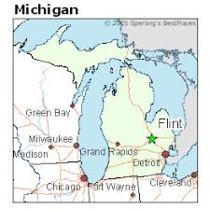
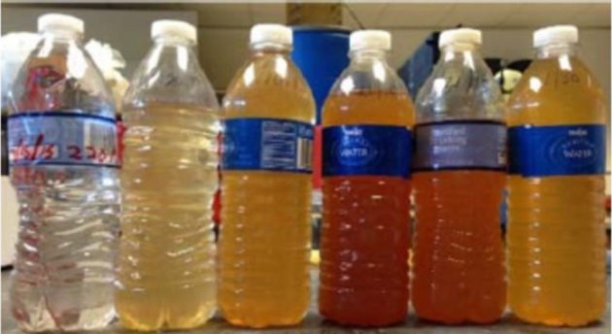
Flint Michigan Water Crisis
Began in 2014
Lead levels dangerously highs
10 deaths due to pneumonia caused by bacteria

Slide 5
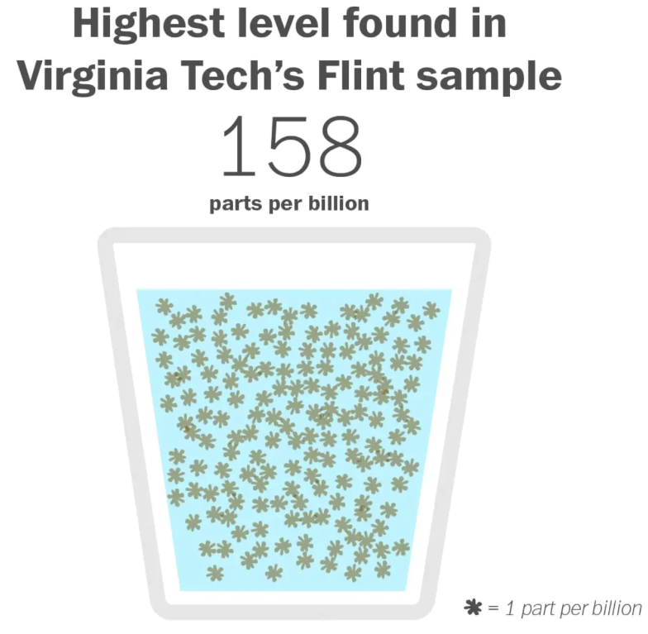
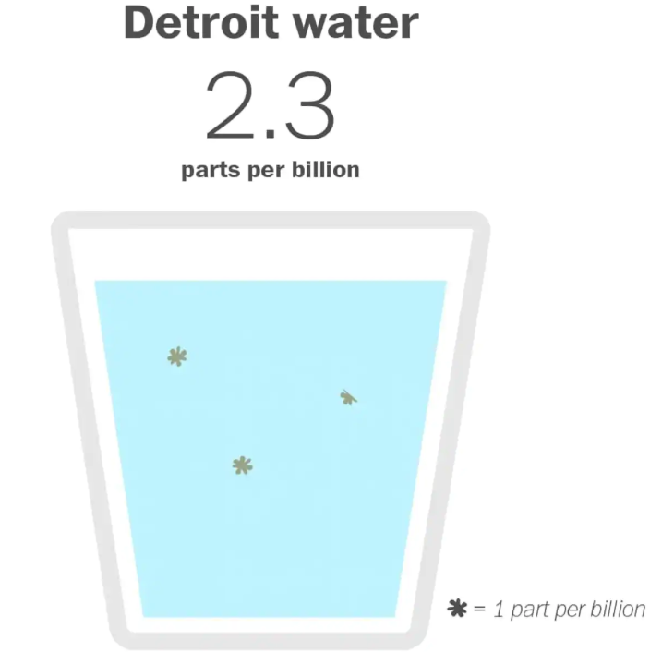
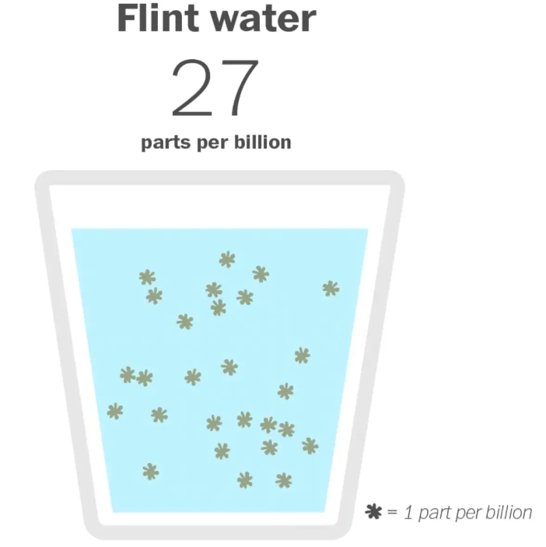
Flint Michigan Water Lead Levels
https://www.washingtonpost.com/news/wonk/wp/2016/01/15/this-is-how-toxic-flints-water-really-is/?utm_term=.22c52842b8ad

Slide 6
Molarity
Left: 2 Molar Solution
Right: 0.5 Molar Solution

Slide 7
Example #1
Determine the molarity of a solution of CuCl₂ when 540. g CuCl₂ is dissolved to form a solution with a final volume of 2,000. mL.
Notes:
What is the purpose of the quicksand video?

Slide 8
Demonstration #1
Determine which solution(s) have the greatest concentration.
1) | A only
2) | B only
3) | C only
4) | A and B
5) | A and C
Notes:
What is the purpose of the quicksand video?

Slide 9
Demonstration #1
Determine which solution(s) have the greatest volume.
1) | A only
2) | B only
3) | C only
4) | A and B
5) | A and C
Notes:
What is the purpose of the quicksand video?

Slide 10
Demonstration #1
Determine which solution(s) have the greatest moles of solute.
1) | A only
2) | B only
3) | C only
4) | A and B
5) | A and C
Notes:
What is the purpose of the quicksand video?

Slide 11
Clicker #1
Which of the following will change a 500.0 mL solution with a concentration of 2.00 M to a concentration of 4.00 M?
Allow 250.0 mL of water to evaporate from the solution.
Dissolve another 1.00 mole of solute into the solution (assume no volume change).
Add 250.0 mL of water to the solution.
Both (a) and (b) are correct.
(a), (b), and (c) are correct
.

Slide 12
Clicker #2 & Demonstration
Solutions B and C are poured together. What is the molarity of the new solution?
A) 3.00 M
B) 2.00 M
C) 1.67 M
D) 1.50 M
E) 1.33 M
Notes:
What is the purpose of the quicksand video?

Slide 13
Example #2
You have a 2.00 M solution of copper(II) chloride. You need to make 100.0 mL of a 0.75 M solution. How would you do this?
Notes:
What is the purpose of the quicksand video?

Slide 14
Clicker#3
What are the concentrations of copper(II) and chloride ions in 100.0 mL of a 0.75 M copper(II) chloride solution?
 | Cu⁺² | Cl⁻
A) | 0.75 M | 0.75 M
B) | 1.50 M | 0.75 M
C) | 0.75 M | 1.50 M
D) | 1.50 M | 1.50 M
E) | 0.75 M | 3.00 M
Notes:
What is the purpose of the quicksand video?

Slide 15
Example #3
Sodium carbonate and calcium chloride react according to the balanced equation below. What volume of 0.125 M sodium carbonate solution (in mL) would be needed to completely react with 37.2 mL of 0.105 M CaCl₂?
Na₂CO_{3(aq)} + CaCl_{2(aq)} → CaCO_{3(s)} + 2NaCl_{(aq)}
Notes:
What is the purpose of the quicksand video?

