Slide 1
Announcements
Be respectful – no electronics please!
Textbook homework Assignment 2 due tomorrow in discussion (pg. 16)
Pre & Post-lecture Assignments (Lon-Capa)
8:00 am Tuesday & Thursday
Electronic Homework #2 due Wednesday at 10:00 pm
First Lab on Monday, lab write-up 1 due next Friday in discussion

Slide 3
Check-In #1
What is the molar mass of hydrogen gas (H₂)?
1) 1.01 amu
2) 2.02 amu
3) 4.04 g/mol
4) 1.01 g/mol
5) 2.02 g/mol

Slide 4
Check-In #2
What mass is 7.00x10²³ atoms C? Pick the correct work.
1) $7.00×{10}^{23}atoms C×\frac{1 mol C}{6.022×{10}^{23}atoms C}×\frac{12.011 g C}{1 mol C}=$
2) $7.00×{10}^{23}atoms C×\frac{12.011 g C}{1 atom C}=$
3) $7.00×{10}^{23}atoms C×\frac{6.022×{10}^{23}atoms C}{1 mol C}×\frac{12.011 g C}{1 mol C}=$

Slide 5
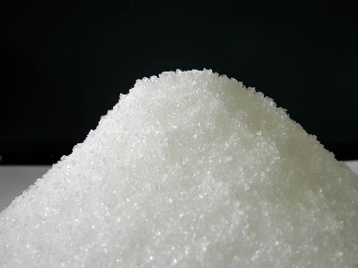
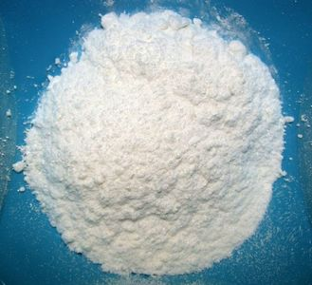
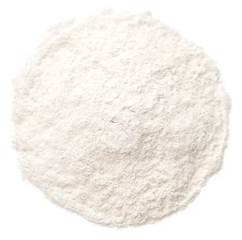
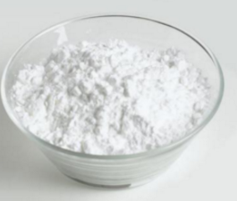
C, H, and O Compounds
Substance | Formula | Appearance
Sucrose | C₁₂H₂₂O₁₁
Aspirin | C₉H₈O₄
Vanilla | C₈H₈O₃
Glucose | C₆H₁₂O₆

Slide 6
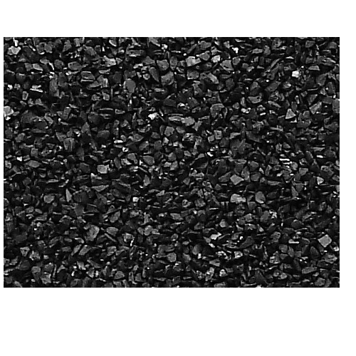
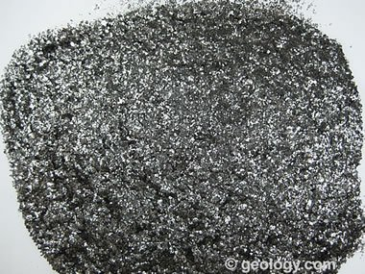
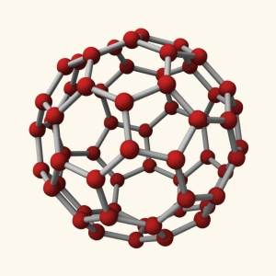
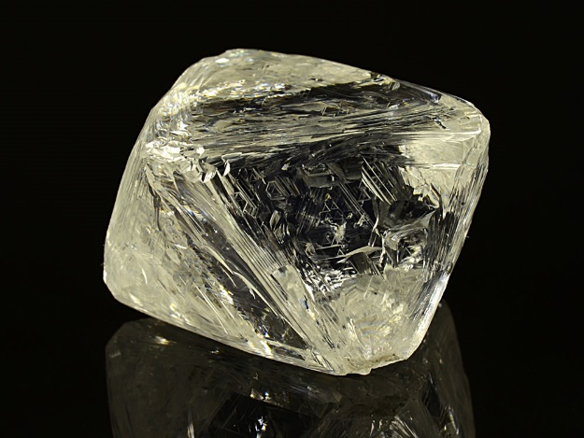
Carbon Allotropes
Allotropes of Carbon

Slide 7
Demonstration
C₁₂H₂₂O₁₁
From this demonstration…
Look for evidence that carbon is present in the sugar molecules.
Look for evidence that water vapor is released as the sugar decomposes.

Slide 8
C, H, and O Compounds
Substance | Formula | Appearance
Sucrose | C₁₂H₂₂O₁₁
Aspirin | C₉H₈O₄
Vanilla | C₈H₈O₃
Glucose | C₆H₁₂O₆

Slide 9
Example
What is the percent (by mass) of carbon in sucrose (C₁₂H₂₂O₁₁)?

Slide 10
One more…
What is the percent mass of hydrogen in each?
H₂O vs. H₂O₂

Slide 11
Clicker #1
Which compound has a greater percent by mass of oxygen?
Magnesium oxide
Sodium oxide

Slide 12
Example
A compound containing carbon and hydrogen is burned in oxygen and the products of 6.25 g C and 1.31 g H are collected. Determine the empirical formula of this compound.

Slide 13
Clicker #2
How many of the following could be the molecular formula for this compound?
C₂H₅ C₄H₁₀ C₆H₁₅ C₈H₂₀
0 (none)
1
2
3
4 (all)

Slide 14
Clicker #3
The molar mass of this compound is 58.1 g/mol. Which of the following is the molecular formula for this compound?
C₂H₅
C₄H₁₀
C₆H₁₅
C₈H₂₀
none

Slide 15
New Example
You have some “nitrogen oxide” compound and you want to figure out what it is (both the formula and the name). You know it’s 30.4% nitrogen by mass and the molar mass is 92.0 g/mol.
N_{x}O_{y} = formula?
name?

Slide 16
Consider the problem…
If you have equal masses of each compound (H₂SO₄, C₁₂H₂₂O₁₁, KClO₃), which one has the greatest number of oxygen atoms?

