Slide 1
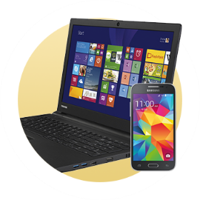
Announcements
Be respectful – no electronics please!
Pre & Post-lecture Assignments (Lon-Capa)
8:00 am Tuesday & Thursday
Electronic Homework #2 due Wednesday (tomorrow) at 10:00 pm
Lab write-up 1 due Friday first five minutes of discussion
Textbook homework Assignment 3 due Friday in discussion (pg. 16)

Slide 2
Exam Info – Tues Feb. 18th
15 Multiple Choice Questions
2 Multi-part free response questions
You will be asked to explain.
You will be asked questions that link multiple topics together.
You will be asked questions that you have not seen before that test your understanding and reasoning skills.

Slide 3
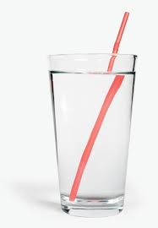
Clicker #1
Will a drinking straw work on the moon? Assume that it is in a glass of water (and the water is staying in the glass).
Yes, it will work the same way.
Yes, but it will not work as well due to less gravity.
Yes, but it will not work as well because there is no air.
No, it will not work because there is less gravity.
No, it will not work because there is no air.

Slide 4
Kinetic Molecular Theory
Gas particles are in constant random motion.
Pressure is due to force of particle collisions with the container walls.
Average kinetic energy of the gas depends entirely on the temperature (in Kelvin).
Particle volume is negligible.*
Gas particles exert no attraction on one another.*

Slide 5
Process
1. Define
The system
Constant variables
Changing variables
2. Explain (use Kinetic Molecular Theory)
3. Draw/Diagram

Slide 6
Clicker #2
As the temperature of the gas in the aerosol can increases, the pressure in the can will
A) increase
B) decrease
C) stay the same

Slide 7
Process
1. Define
The system
Constant variables
Changing variables
2. Explain (use Kinetic Molecular Theory)
3. Draw/Diagram

Slide 8
Clicker #3
Is the pressure in the larger balloon greater than, less than, or about equal to the pressure in the smaller balloon?
A) greater than the smaller balloon
B) less than the smaller balloon
C) equal to the smaller balloon

Slide 9
Process
1. Define
The system
Constant variables
Changing variables
2. Explain (use Kinetic Molecular Theory)
3. Draw/Diagram

Slide 10
Clicker #1
Will a drinking straw work on the moon? Assume that it is in a glass of water (and the water is staying in the glass).
Yes, it will work the same way.
Yes, but it will not work as well due to less gravity.
Yes, but it will not work as well because there is no air.
No, it will not work because there is less gravity.
No, it will not work because there is no air.

Slide 11
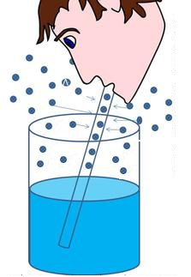
The Straw
1. Define
The system
Constant variables
Changing variables
2. Explain (use Kinetic Molecular Theory)
3. Draw/Diagram

Slide 12
Video
https://www.youtube.com/watch?v=Ucpw6DO0wq8

