Slide 1
Announcements
Be respectful – no electronics please!
Exam 1 – Tuesday February 18th, 7:00 pm
Ice cream contest
Pre & Post-lecture Assignments (Lon-Capa)
8 am next Thursday
Lab write-up 2 due tomorrow in discussion
Textbook homework Assignment 4 due tomorrow in discussion (pg. 16)
Review Questions Part 1 Due Friday at 10:00 pm in Lon-Capa (will work on during discussion)

Slide 2
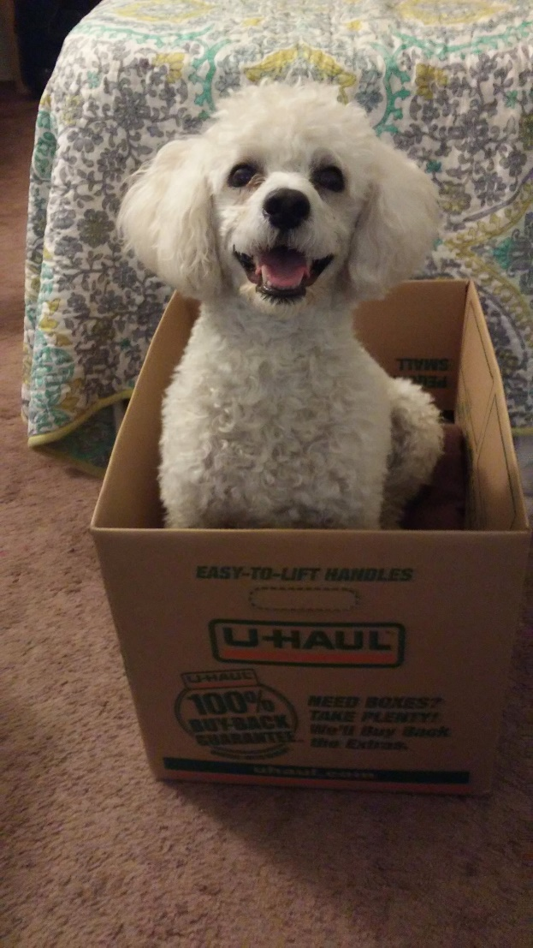
Joke of the Day
What kind of dog do chemists have?
Laboratory retrievers!

Slide 3
Exam Info – February 18
Be respectful – no electronics please!
Conflict exam: Same day
5-6:30 pm in Noyes 165
Sign up in 1026 Chem Annex by noon on 2/18
Please email me today if you have a conflict with both the regular exam and the conflict exam.
Practice Exams posted online!
My Question & Answer Session this weekend:
Sunday 5-6 pm in 152 Chem Annex
You may use a calculator (NOT TI-Nspire.)

Slide 4
Exam 1 Topics
Major Topics
Minor Topics
Matter
Naming
Memorize polyatomics, especially those ending in “-ate”, hydroxide, ammonium
The mole
Empirical & molecular formula
Gases & related problems
Isotopes & ions (protons, neutrons, electrons)
Conversion problems
Density
Chemical & physical changes
Not Tested
Significant Figures

Slide 5
Exam Format – 90 minutes total
15 Multiple Choice Questions
2 Free Response Questions
5 possible choices
50% of test grade
~3 minutes to answer each
Write in answers – both qualitative and quantitative
50% of test grade
***A periodic table & cover sheet with
equations will be attached.***

Slide 6
Metacognition & Reasoning
Can I visualize what’s happening?
What are the principles and tools I can use to solve this?
Why can I use these?
Is the answer reasonable?

Slide 7
Some Tools & Principles
particles (atoms or molecules)
$$×\frac{1 mole}{molar mass g}$$
$$×\frac{6.022×{10}^{23}}{1 mole}$$
grams
moles
$$×\frac{molar mass g}{1 mole}$$
$$×\frac{1 mole}{6.022×{10}^{23}}$$
Use PV=nRT
PV=nRT
(Solve for n)
Gas properties
Other tools:
Dalton’s Law of Partial Pressures
Empirical & Molecular Formula
Naming

Slide 8
Clicker#1
A closed tank consists of a mixture of 4.00 grams of helium and 160. grams of an unknown monatomic gas. The partial pressure of the unknown gas is four times the partial pressure of helium. Identify the gas.
a) Kr
b) Tb
c) Ar
d) Br
e) F

Slide 9
Practice Question #2
Problem #118 Part a
A 2.50-L flexible balloon at 1.00 atm and -48°C is filled with 2.71 g of a monatomic gas. Determine the identity of the gas.

Slide 10
Clicker #2
Problem #118 Part b
Determine what will happen when 10.0 g of oxygen gas is added to the balloon. Compare the balloon before the gas has been added to after the gas has been added. *Note: the balloon is a flexible container.
 | Variables that have changed | Variables that are constant
a) | P, V, n | T
b) | V, n | T, P
c) | P, n | V, n
d) | V, T | P, n

Slide 11
Clicker #3
Problem #118 Part b
Compare the volume of the balloon before the 10.0 g of oxygen gas has been added to the volume after the gas has been added.
The volume of the balloon is the same.
The volume of the balloon is larger than it was before but less than twice the size.
The volume of the balloon is twice as large as it was before.
The volume of the balloon is more than twice as large as it was before.

Slide 12
Clicker #4: Naming and Moles
Which has the greatest number of ions if equal mole samples of each are dissolved in water?
Iron(III) nitrate
Sodium fluoride
Potassium phosphate
Magnesium acetate
At least two of the above have the same greatest number of ions.

Slide 13
Clicker #5: Ions & Isotopes
A certain ion has 27 electrons and 34 neutrons. Which of the following correctly identifies both the ion and its mass number?
Ion Mass Number
a) Cu²⁺ 63
b) Cu²⁺ 61
c) Co²⁺ 61
d) Co²⁺ 59
e) Se^{2–} 61

Slide 14
Clicker #6: Percent Composition & Naming
Which has the greatest number of sodium atoms if equal mass samples of each are dissolved in water?
Sodium carbonate
Sodium chloride

Slide 15
Problem #7: Gases
You are holding two balloons of the same volume. One balloon contains 1.0 g of helium. The other balloon contains neon. Calculate the mass of neon in the balloon.

