Slide 1
Lecture 6
Titrations I

Slide 2
Titrations (p. 101)
Titrations refer to running a controlled acid-base reaction using a buret. This week, we will study four types acid-base titrations in detail.

Slide 3
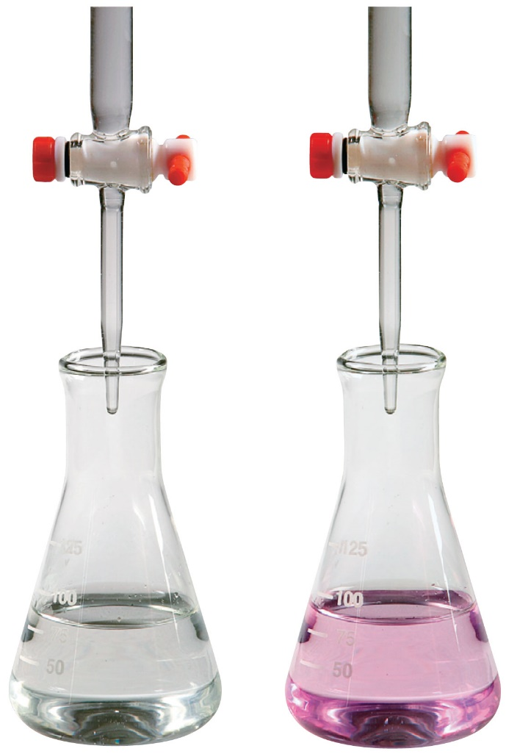
Acid and Base Titration Apparatus flask + buret
Photo © Brooks/Cole, Cengage Learning Company. All rights reserved.

Slide 4
Titrations (p. 101)
Titrations refer to running a controlled acid-base reaction using a buret. This week, we will study three types acid-base titrations in detail. They are:
1. Strong acid (like HCl) titrated by a strong base (like KOH) – SA by SB

Slide 5
Titrations (p. 101)
Titrations refer to running a controlled acid-base reaction using a buret. This week, we will study three types acid-base titrations in detail. They are:
1. Strong acid (like HCl) titrated by a strong base (like KOH) – SA by SB
2. Strong base [like Ca(OH)₂] titrated by a strong acid (like HNO₃) – SB by SA

Slide 6
Titrations (p. 101)
Titrations refer to running a controlled acid-base reaction using a buret. This week, we will study three types acid-base titrations in detail. They are:
1. Strong acid (like HCl) titrated by a strong base (like KOH) – SA by SB
2. Strong base [like Ca(OH)₂] titrated by a strong acid (like HNO₃) – SB by SA
3. Weak acid (like HC₂H₃O₂, K_{a} = 1.8 x 10⁻⁵) titrated by a strong base (like NaOH) – WA by SB

Slide 7
Titrations (p. 101)
Titrations refer to running a controlled acid-base reaction using a buret. This week, we will study three types acid-base titrations in detail. They are:
1. Strong acid (like HCl) titrated by a strong base (like KOH) – SA by SB
2. Strong base [like Ca(OH)₂] titrated by a strong acid (like HNO₃) – SB by SA
3. Weak acid (like HC₂H₃O₂, K_{a} = 1.8 x 10⁻⁵) titrated by a strong base (like NaOH) – WA by SB
4. Weak base (like C₆H₅NH₂, K_{b} = 3.8 x 10⁻¹⁰) by a strong acid (like HI) – WB by SA

Slide 8
Titration Definitions (p. 100)
Titrant – substance in buret that is added in controlled amounts; always a strong acid or a strong base.
Neutralization reaction – reaction between beaker contents and the titrant; always assumed to go to completion because a strong acid and/or strong base is reacted.

Slide 9
Titrant-stuff in the buret
Photo © Brooks/Cole, Cengage Learning Company. All rights reserved.

Slide 10
Titration Definitions (p. 100)
Titrant – substance in buret that is added in controlled amounts; always a strong acid or a strong base.
Neutralization reaction – reaction between beaker contents and the titrant; always assumed to go to completion because a strong acid and/or strong base is reacted.

Slide 11
Example Neutralization Reactions
1. Strong acid (like HCl) titrated by a strong base (like KOH): H⁺ + OH⁻ → H₂O
2. Strong base [like Ca(OH)₂] titrated by a strong acid (like HNO₃): OH⁻ + H⁺ → H₂O
3. Weak acid (like HC₂H₃O₂, K_{a} = 1.8 x 10⁻⁵) titrated by a strong base (like NaOH):
HC₂H₃O₂ + OH⁻ → C₂H₃O₂⁻ + H₂O
4. Weak base (like C₆H₅NH₂, K_{b} = 3.8 x 10⁻¹⁰) by a strong acid (like HI):
C₆H₅NH₂ + H⁺ → C₆H₅NH₃⁺

Slide 12
More Definitions (p. 100)
Equivalence Point – when enough titrant has been added to exactly neutralize (react with) all the acid or base present initially. At the equivalence point (assuming a 1:1 mol relationship in balanced equation):
moles acid = moles base

Slide 13
Indicators mark the Equivalence Point
Photo © Brooks/Cole, Cengage Learning Company. All rights reserved.

Slide 14
More Definitions (p. 100)
Equivalence Point – when enough titrant has been added to exactly neutralize (react with) all the acid or base present initially. At the equivalence point (assuming a 1:1 mol relationship in balanced equation):
moles acid = moles base

Slide 15
More Definitions
To determine moles of solute, we multiply the molarity times the volume.
M x V =

Slide 16
More Definitions (p. 100)
Equivalence Point – when enough titrant has been added to exactly neutralize (react with) all the acid or base present initially. At the equivalence point (assuming a 1:1 mol relationship in balanced equation):
moles acid = moles base
M_{A}V_{A} = M_{B}V_{B}

Slide 17
100.0 mL of 0.500 M HF titrated by 1.00 M NaOH (p. 104)
What volume of NaOH is required to reach the equivalence point?

Slide 18
100.0 mL of 0.500 M HF titrated by 1.00 M NaOH (p. 104)
What volume of NaOH is required to reach the equivalence point?
M_{A}V_{A} = M_{B}V_{B} (At equiv. point, mol HF = mol OH⁻ added)
0.500 M(0.1000 L) = 1.00 M(V_{NaOH})
V_{NaOH} = 0.0500 L

Slide 19
Working with mmols (p. 101)
Molarity can also be defined as mmol/mL:
molarity = M = mol/L = mmol/mL

Slide 20
100.0 mL of 0.500 M HF titrated by 1.00 M NaOH (p. 104)
What volume of NaOH is required to reach the equivalence point?
M_{A}V_{A} = M_{B}V_{B} , 0.500 M(0.1000 L) = 1.00 M(V_{NaOH}),
V_{NaOH} = 0.0500 L
Using mmol/mL definition for molarity:
M_{A}V_{A} = M_{B}V_{B} , 0.500 M(100.0 mL) = 1.00 M(V_{NaOH}),
V_{NaOH} = 50.0 mL

Slide 21
Titration (pH) Curve – a plot of pH of solution vs. volume of titrant added

Slide 22
Titration (pH) Curve – a plot of pH of solution vs. volume of titrant added
pH curve for a strong acid titrated by strong base
pH curve for a strong base titrated by strong acid

Slide 23
More Titration (pH) Curves
pH curve for a weak acid titrated by strong base
pH curve for weak base titrated by strong acid

Slide 25
Clicker Question
Consider the following three titrations:
I. 50.0 mL of 0.1 M HCO₂H (K_{a} ≈ 1 x 10⁻⁴) by 0.20 M KOH
II. 50.0 mL of 0.1 M HOC₆H₅ (K_{a} ≈ 1 x 10⁻¹⁰) by 0.20 M KOH
III. 50.0 mL of 0.1 M HNO₃ by 0.20 M KOH
Which of the following statements is false?
a. The HNO₃ titration has a lower pH initially before the titration begins as compared to the other titrations.
b. At 12.5 mL KOH added, the HCO₂H titration has pH ≈ 4.0.
c. At the halfway point to equivalence for the HOC₆H₅ titration, the pH is acidic.
d. The pH of the HOC₆H₅ titration has a higher pH at the equivalence point as compared to the HCO₂H titration.
e. The pH of the HNO₃ titration is 7.0 at 25.0 mL KOH added.

Slide 26
Multiple Acid Titration (pH) Curves

Slide 27
Clicker Question
Consider the following two titrations:
I. 50.0 mL of 0.1 M HCO₂H (K_{a} ≈ 1 x 10⁻⁴) by 0.20 M KOH
II. 50.0 mL of 0.1 M HOC₆H₅ (K_{a} ≈ 1 x 10⁻¹⁰) by 0.20 M KOH
Which of the following statements is false?
a. The HCO₂H titration has a lower pH initially before the titration begins as compared to the HOC₆H₅ titration.
b. At 12.5 mL KOH added, the HCO₂H titration has pH ≈ 4.0.
c. At the halfway point to equivalence for the HOC₆H₅ titration, the pH is acidic.
d. The pH of the HOC₆H₅ titration has a higher pH at the equivalence point as compared to the HCO₂H titration.
e. The pH of the HCO₂H titration is basic at 25.0 mL KOH added.

Slide 29
Strong Acid – Strong Base Titrations

Slide 30
Titration (pH) Curve – a plot of pH of solution vs. volume of titrant added
pH curve for a strong acid titrated by strong base
pH curve for a strong base titrated by strong acid

Slide 31
Weak Acid-Strong Base Titrations
100.0 mL of 0.50
M HF titrated by 1.0 M NaOH
Neutralization rxn:
HF + OH⁻ → F⁻ + H₂O

Slide 32
Weak Acid vs. Strong Acid Titration
HA + OH⁻ → A⁻ + H₂O

Slide 33
Weak Acid-Strong Base Titrations
100.0 mL of 0.50
M HF titrated by 1.0 M NaOH
Neutralization rxn:
HF + OH⁻ → F⁻ + H₂O

Slide 34
Multiple Acid Titration (pH) Curves

Slide 35
Clicker Question
Consider the following three titrations:
I. 50.0 mL of 0.1 M HCO₂H (K_{a} ≈ 1 x 10⁻⁴) by 0.20 M KOH
II. 50.0 mL of 0.1 M HOC₆H₅ (K_{a} ≈ 1 x 10⁻¹⁰) by 0.20 M KOH
III. 50.0 mL of 0.1 M HNO₃ by 0.20 M KOH
Which of the following statements is false?
a. The HNO₃ titration has a lower pH initially before the titration begins as compared to the other titrations.
b. At 12.5 mL KOH added, the HCO₂H titration has pH ≈ 4.0.
c. At the halfway point to equivalence for the HOC₆H₅ titration, the pH is acidic.
d. The pH of the HOC₆H₅ titration has a higher pH at the equivalence point as compared to the HCO₂H titration.
e. The pH of the HNO₃ titration is 7.0 at 25.0 mL KOH added.

Slide 36
Clicker Question
Consider the following two titrations:
I. 50.0 mL of 0.1 M HCO₂H (K_{a} ≈ 1 x 10⁻⁴) by 0.20 M KOH
II. 50.0 mL of 0.1 M HOC₆H₅ (K_{a} ≈ 1 x 10⁻¹⁰) by 0.20 M KOH
Which of the following statements is false?
a. The HCO₂H titration has a lower pH initially before the titration begins as compared to the HOC₆H₅ titration.
b. At 12.5 mL KOH added, the HCO₂H titration has pH ≈ 4.0.
c. At the halfway point to equivalence for the HOC₆H₅ titration, the pH is acidic.
d. The pH of the HOC₆H₅ titration has a higher pH at the equivalence point as compared to the HCO₂H titration.
e. The pH of the HCO₂H titration is basic at 25.0 mL KOH added.

Slide 37
Multiple Acid Titration (pH) Curves

Slide 38
Titration (pH) Curve – a plot of pH of solution vs. volume of titrant added
pH curve for a strong acid titrated by strong base
pH curve for a strong base titrated by strong acid

Slide 39
Working with mmols (p. 101)
Molarity can also be defined as mmol/mL:
molarity = M = mol/L = mmol/mL
M_{A}V_{A} = M_{B}V_{B}
mmol acid = mmol base At equivalence point.
with M in mmol/mL and V in mL

