Slide 1
Lecture 7
Titrations II

Slide 2
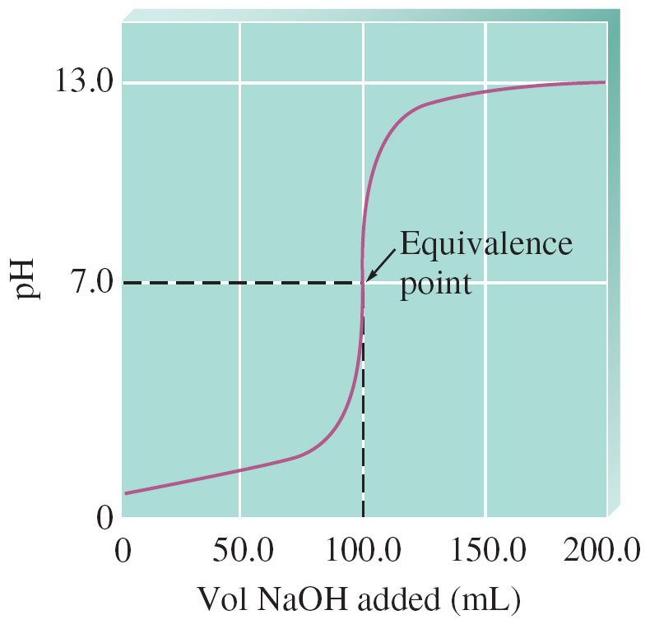
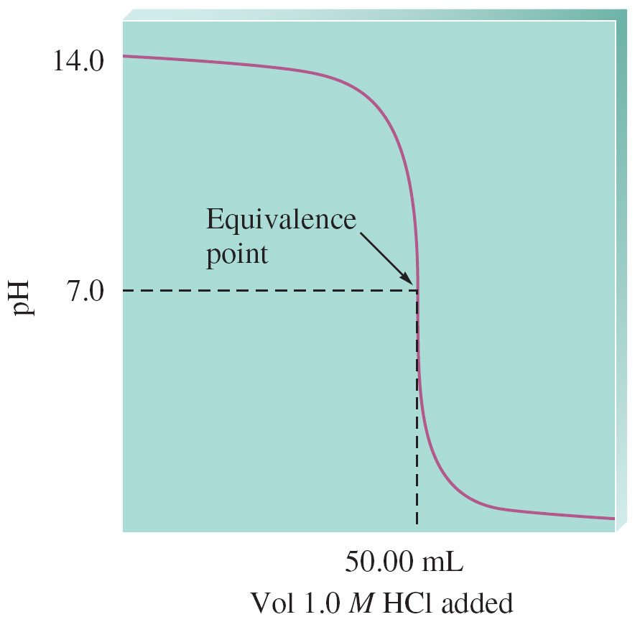
Titration (pH) Curve – a plot of pH of solution vs. volume of titrant added
pH curve for a strong acid titrated by strong base
pH curve for a strong base titrated by strong acid

Slide 3
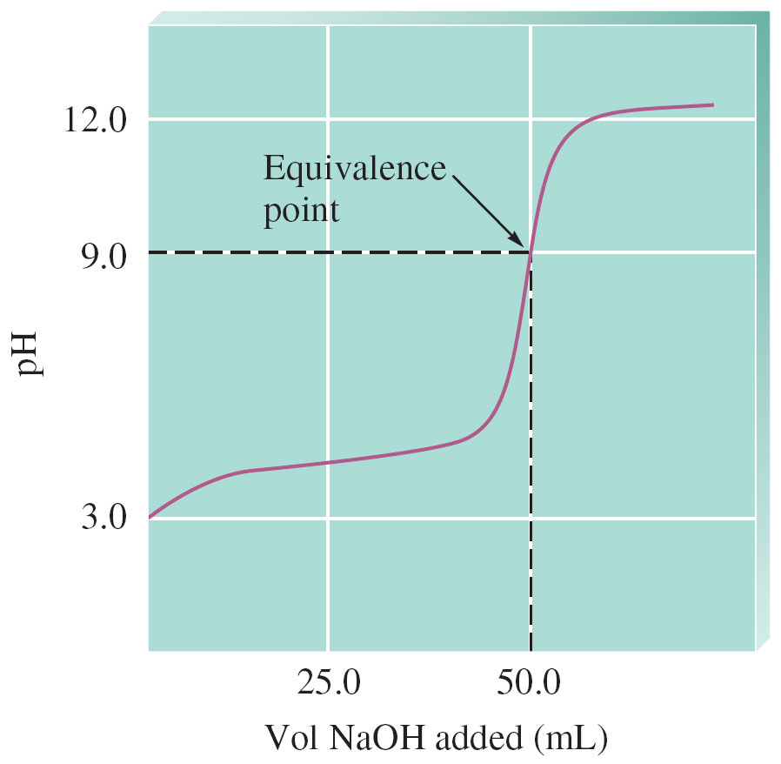
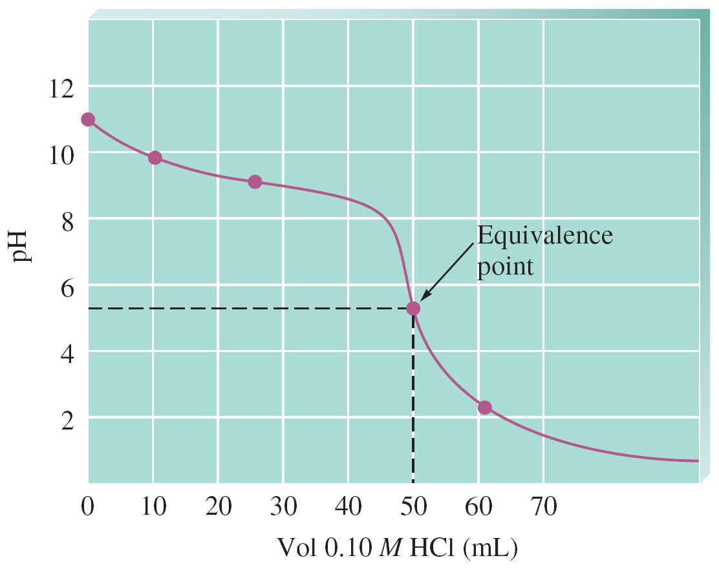
More Titration (pH) Curves
pH curve for a weak acid titrated by strong base
pH curve for weak base titrated by strong acid

Slide 4
Lecture Question 1 – p 105a
Consider the following 5 titrations:
I. 50.0 mL of 0.1 M HONH₂ (K_{b} ≈ 1 x 10⁻⁸) by 0.20 M HBr
II. 50.0 mL of 0.1 M HOC₆H₅ (K_{a} ≈ 1 x 10⁻¹⁰) by 0.20 M KOH
III. 50.0 mL of 0.1 M Ca(OH)₂ by 0.20 M HBr
IV. 50.0 mL of 0.1 M (C₂H₅)₂NH (K_{b} ≈ 1 x 10⁻³) by 0.20 M HBr
V. 50.0 mL of 0.1 M HNO₃ by 0.20 M KOH
Rank these titrations in order of increasing pH at the halfway point to equivalence.
a. V<I<II<IV<III b. V<IV<I<II<III c. V<II<I<IV<III d. V<II<IV<I<III

Slide 5
Lecture Question 2 – p 105a
Consider the following 4 titrations:
I. 50.0 mL of 0.1 M HONH₂ (K_{b} ≈ 1 x 10⁻⁸) by 0.20 M HBr
II. 50.0 mL of 0.1 M HOC₆H₅ (K_{a} ≈ 1 x 10⁻¹⁰) by 0.20 M KOH
III. 50.0 mL of 0.1 M Ca(OH)₂ by 0.20 M HBr
IV. 50.0 mL of 0.1 M (C₂H₅)₂NH (K_{b} ≈ 1 x 10⁻³) by 0.20 M HBr
Rank these titrations in order of increasing pH at the equivalence point.
a. I<IV<III<II b. IV<I<III<II c. III<II<IV<I d. II<III<I<IV

Slide 6
Lecture Question 1 – p 105a
Consider the following 5 titrations:
I. 50.0 mL of 0.1 M HONH₂ (K_{b} ≈ 1 x 10⁻⁸) by 0.20 M HBr
II. 50.0 mL of 0.1 M HOC₆H₅ (K_{a} ≈ 1 x 10⁻¹⁰) by 0.20 M KOH
III. 50.0 mL of 0.1 M Ca(OH)₂ by 0.20 M HBr
IV. 50.0 mL of 0.1 M (C₂H₅)₂NH (K_{b} ≈ 1 x 10⁻³) by 0.20 M HBr
V. 50.0 mL of 0.1 M HNO₃ by 0.20 M KOH
Rank these titrations in order of increasing pH at the halfway point to equivalence.
a. V<I<II<IV<III b. V<IV<I<II<III c. V<II<I<IV<III d. V<II<IV<I<III

Slide 7
Titration (pH) Curve – a plot of pH of solution vs. volume of titrant added
pH curve for a strong acid titrated by strong base
pH curve for a strong base titrated by strong acid

Slide 8
More Titration (pH) Curves
pH curve for a weak acid titrated by strong base
pH curve for weak base titrated by strong acid

Slide 9
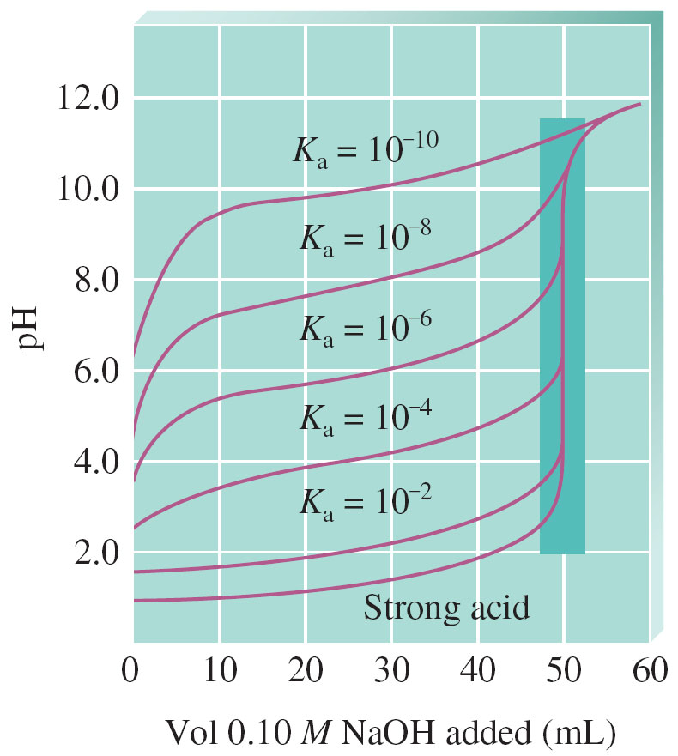
Multiple Acid Titration (pH) Curves

Slide 10
Lecture Question 1
Consider the following 5 titrations:
I. 50.0 mL of 0.1 M HONH₂ (K_{b} ≈ 1 x 10⁻⁸) by 0.20 M HBr
II. 50.0 mL of 0.1 M HOC₆H₅ (K_{a} ≈ 1 x 10⁻¹⁰) by 0.20 M KOH
III. 50.0 mL of 0.1 M Ca(OH)₂ by 0.20 M HBr
IV. 50.0 mL of 0.1 M (C₂H₅)₂NH (K_{b} ≈ 1 x 10⁻³) by 0.20 M HBr
V. 50.0 mL of 0.1 M HNO₃ by 0.20 M KOH
Rank these titrations in order of increasing pH at the halfway point to equivalence.
a. V<I<II<IV<III b. V<IV<I<II<III c. V<II<I<IV<III d. V<II<IV<I<III

Slide 11
Lecture Question 1
Consider the following 5 titrations:
I. 50.0 mL of 0.1 M HONH₂ (K_{b} ≈ 1 x 10⁻⁸) by 0.20 M HBr
II. 50.0 mL of 0.1 M HOC₆H₅ (K_{a} ≈ 1 x 10⁻¹⁰) by 0.20 M KOH
III. 50.0 mL of 0.1 M Ca(OH)₂ by 0.20 M HBr
IV. 50.0 mL of 0.1 M (C₂H₅)₂NH (K_{b} ≈ 1 x 10⁻³) by 0.20 M HBr
V. 50.0 mL of 0.1 M HNO₃ by 0.20 M KOH
Rank these titrations in order of increasing pH at the halfway point to equivalence.
a. V<I<II<IV<III b. V<IV<I<II<III c. V<II<I<IV<III d. V<II<IV<I<III

Slide 12
Lecture Question 2
Consider the following 4 titrations:
I. 50.0 mL of 0.1 M HONH₂ (K_{b} ≈ 1 x 10⁻⁸) by 0.20 M HBr
II. 50.0 mL of 0.1 M HOC₆H₅ (K_{a} ≈ 1 x 10⁻¹⁰) by 0.20 M KOH
III. 50.0 mL of 0.1 M Ca(OH)₂ by 0.20 M HBr
IV. 50.0 mL of 0.1 M (C₂H₅)₂NH (K_{b} ≈ 1 x 10⁻³) by 0.20 M HBr
Rank these titrations in order of increasing pH at the equivalence point.
a. I<IV<III<II b. IV<I<III<II c. III<II<IV<I d. II<III<I<IV

Slide 13
Titration (pH) Curve – a plot of pH of solution vs. volume of titrant added
pH curve for a strong acid titrated by strong base
pH curve for a strong base titrated by strong acid

Slide 14
More Titration (pH) Curves
pH curve for a weak acid titrated by strong base
pH curve for weak base titrated by strong acid

Slide 15
Lecture Question 2
Consider the following 4 titrations:
I. 50.0 mL of 0.1 M HONH₂ (K_{b} ≈ 1 x 10⁻⁸) by 0.20 M HBr
II. 50.0 mL of 0.1 M HOC₆H₅ (K_{a} ≈ 1 x 10⁻¹⁰) by 0.20 M KOH
III. 50.0 mL of 0.1 M Ca(OH)₂ by 0.20 M HBr
IV. 50.0 mL of 0.1 M (C₂H₅)₂NH (K_{b} ≈ 1 x 10⁻³) by 0.20 M HBr
Rank these titrations in order of increasing pH at the equivalence point.
a. I<IV<III<II b. IV<I<III<II c. III<II<IV<I d. II<III<I<IV

Slide 16
Lecture Question 2
Consider the following 4 titrations:
I. 50.0 mL of 0.1 M HONH₂ (K_{b} ≈ 1 x 10⁻⁸) by 0.20 M HBr
II. 50.0 mL of 0.1 M HOC₆H₅ (K_{a} ≈ 1 x 10⁻¹⁰) by 0.20 M KOH
III. 50.0 mL of 0.1 M Ca(OH)₂ by 0.20 M HBr
IV. 50.0 mL of 0.1 M (C₂H₅)₂NH (K_{b} ≈ 1 x 10⁻³) by 0.20 M HBr
Rank these titrations in order of increasing pH at the equivalence point.
a. I<IV<III<II b. IV<I<III<II c. III<II<IV<I d. II<III<I<IV

Slide 17
Lecture Question 1
Consider the following 5 titrations:
I. 50.0 mL of 0.1 M HONH₂ (K_{b} ≈ 1 x 10⁻⁸) by 0.20 M HBr
II. 50.0 mL of 0.1 M HOC₆H₅ (K_{a} ≈ 1 x 10⁻¹⁰) by 0.20 M KOH
III. 50.0 mL of 0.1 M Ca(OH)₂ by 0.20 M HBr
IV. 50.0 mL of 0.1 M (C₂H₅)₂NH (K_{b} ≈ 1 x 10⁻³) by 0.20 M HBr
V. 50.0 mL of 0.1 M HNO₃ by 0.20 M KOH
Rank these titrations in order of increasing pH at the halfway point to equivalence.
a. V<I<II<IV<III b. V<IV<I<II<III c. V<II<I<IV<III d. V<II<IV<I<III

Slide 19
Strong Acid – Strong Base Titrations

Slide 20
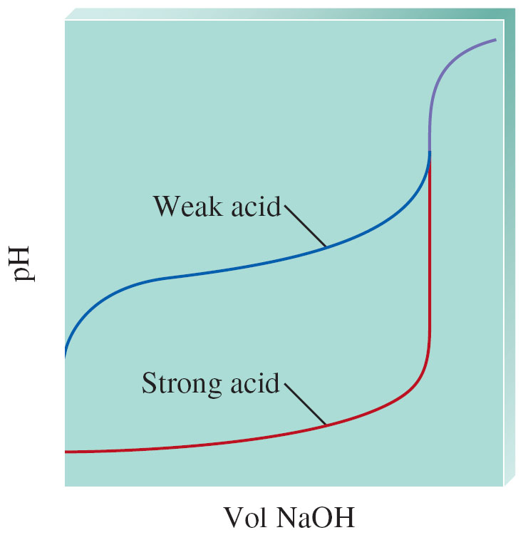
Weak Acid vs. Strong Acid Titration

Slide 21
Weak Acid-Strong Base Titrations
100.0 mL of 0.50
M HF titrated by 1.0 M NaOH
Neutralization rxn:
HF + OH⁻ → F⁻ + H₂O

Slide 22
Clicker Question
Consider the following two titrations:
I. 50.0 mL of 0.1 M HCO₂H (K_{a} ≈ 1 x 10⁻⁴) by 0.20 M KOH
II. 50.0 mL of 0.1 M HOC₆H₅ (K_{a} ≈ 1 x 10⁻¹⁰) by 0.20 M KOH
III. 50.0 mL of 0.1 M HNO₃ by 0.20 M KOH
Which of the following statements is false?
a. The HNO₃ titration has a lower pH initially before the titration begins as compared to the other titrations.
b. At 12.5 mL KOH added, the HCO₂H titration has pH ≈ 4.0.
c. At the halfway point to equivalence for the HOC₆H₅ titration, the pH is acidic.
d. The pH of the HOC₆H₅ titration has a higher pH at the equivalence point as compared to the HCO₂H titration.
e. The pH of the HNO₃ titration is 7.0 at 25.0 mL KOH added.

Slide 24
Clicker Question
Consider the following two titrations:
I. 50.0 mL of 0.1 M HCO₂H (K_{a} ≈ 1 x 10⁻⁴) by 0.20 M KOH
II. 50.0 mL of 0.1 M HOC₆H₅ (K_{a} ≈ 1 x 10⁻¹⁰) by 0.20 M KOH
III. 50.0 mL of 0.1 M HNO₃ by 0.20 M KOH
Which of the following statements is false?
a. The HNO₃ titration has a lower pH initially before the titration begins as compared to the other titrations.
b. At 12.5 mL KOH added, the HCO₂H titration has pH ≈ 4.0.
c. At the halfway point to equivalence for the HOC₆H₅ titration, the pH is acidic.
d. The pH of the HOC₆H₅ titration has a higher pH at the equivalence point as compared to the HCO₂H titration.
e. The pH of the HNO₃ titration is 7.0 at 25.0 mL KOH added.

Slide 25
Multiple Acid Titration (pH) Curves

Slide 26
Weak Acid-Strong Base Titrations

Slide 27
Weak Acid vs. Strong Acid Titration

Slide 28
Titration (pH) Curve – a plot of pH of solution vs. volume of titrant added
pH curve for a strong acid titrated by strong base
pH curve for a strong base titrated by strong acid

Slide 29
Weak Base – Strong Acid Titration

Slide 30
Clicker Question
Consider the following 5 titrations:
I. 50.0 mL of 0.1 M HONH₂ (K_{b} ≈ 1 x 10⁻⁸) by 0.20 M HBr
II. 50.0 mL of 0.1 M HOC₆H₅ (K_{a} ≈ 1 x 10⁻¹⁰) by 0.20 M KOH
III. 50.0 mL of 0.1 M Ca(OH)₂ by 0.20 M HBr
IV. 50.0 mL of 0.1 M (C₂H₅)₂NH (K_{b} ≈ 1 x 10⁻³) by 0.20 M HBr
V. 50.0 mL of 0.1 M HNO₃ by 0.20 M KOH
Rank these titrations in order of increasing pH at the halfway point to equivalence.
a. V<I<II<IV<III b. V<IV<I<II<III c. V<II<I<IV<III d. V<II<IV<I<III

Slide 31
Titration (pH) Curve – a plot of pH of solution vs. volume of titrant added
pH curve for a strong acid titrated by strong base
pH curve for a strong base titrated by strong acid

Slide 32
More Titration (pH) Curves
pH curve for a weak acid titrated by strong base
pH curve for weak base titrated by strong acid

Slide 33
Clicker Question
Consider the following 5 titrations:
I. 50.0 mL of 0.1 M HONH₂ (K_{b} ≈ 1 x 10⁻⁸) by 0.20 M HBr
II. 50.0 mL of 0.1 M HOC₆H₅ (K_{a} ≈ 1 x 10⁻¹⁰) by 0.20 M KOH
III. 50.0 mL of 0.1 M Ca(OH)₂ by 0.20 M HBr
IV. 50.0 mL of 0.1 M (C₂H₅)₂NH (K_{b} ≈ 1 x 10⁻³) by 0.20 M HBr
V. 50.0 mL of 0.1 M HNO₃ by 0.20 M KOH
Rank these titrations in order of increasing pH at the halfway point to equivalence.
a. V<I<II<IV<III b. V<IV<I<II<III c. V<II<I<IV<III d. V<II<IV<I<III

Slide 35
Clicker Question
Consider the following 5 titrations:
I. 50.0 mL of 0.1 M HONH₂ (K_{b} ≈ 1 x 10⁻⁸) by 0.20 M HBr
II. 50.0 mL of 0.1 M HOC₆H₅ (K_{a} ≈ 1 x 10⁻¹⁰) by 0.20 M KOH
III. 50.0 mL of 0.1 M Ca(OH)₂ by 0.20 M HBr
IV. 50.0 mL of 0.1 M (C₂H₅)₂NH (K_{b} ≈ 1 x 10⁻³) by 0.20 M HBr
V. 50.0 mL of 0.1 M HNO₃ by 0.20 M KOH
Rank these titrations in order of increasing pH at the halfway point to equivalence.
a. V<I<II<IV<III b. V<IV<I<II<III c. V<II<I<IV<III d. V<II<IV<I<III

Slide 36
Clicker Question
Consider the following 4 titrations:
I. 50.0 mL of 0.1 M HONH₂ (K_{b} ≈ 1 x 10⁻⁸) by 0.20 M HBr
II. 50.0 mL of 0.1 M HOC₆H₅ (K_{a} ≈ 1 x 10⁻¹⁰) by 0.20 M KOH
III. 50.0 mL of 0.1 M Ca(OH)₂ by 0.20 M HBr
IV. 50.0 mL of 0.1 M (C₂H₅)₂NH (K_{b} ≈ 1 x 10⁻³) by 0.20 M HBr
Rank these titrations in order of increasing pH at the equivalence point.
a. I<IV<III<II b. IV<I<III<II c. III<II<IV<I d. II<III<I<IV

Slide 37
Titration (pH) Curve – a plot of pH of solution vs. volume of titrant added
pH curve for a strong acid titrated by strong base
pH curve for a strong base titrated by strong acid

Slide 38
More Titration (pH) Curves
pH curve for a weak acid titrated by strong base
pH curve for weak base titrated by strong acid

Slide 39
Clicker Question
Consider the following 4 titrations:
I. 50.0 mL of 0.1 M HONH₂ (K_{b} ≈ 1 x 10⁻⁸) by 0.20 M HBr
II. 50.0 mL of 0.1 M HOC₆H₅ (K_{a} ≈ 1 x 10⁻¹⁰) by 0.20 M KOH
III. 50.0 mL of 0.1 M Ca(OH)₂ by 0.20 M HBr
IV. 50.0 mL of 0.1 M (C₂H₅)₂NH (K_{b} ≈ 1 x 10⁻³) by 0.20 M HBr
Rank these titrations in order of increasing pH at the equivalence point.
a. I<IV<III<II b. IV<I<III<II c. III<II<IV<I d. II<III<I<IV

Slide 40
Clicker Question
Consider the following 4 titrations:
I. 50.0 mL of 0.1 M HONH₂ (K_{b} ≈ 1 x 10⁻⁸) by 0.20 M HBr
II. 50.0 mL of 0.1 M HOC₆H₅ (K_{a} ≈ 1 x 10⁻¹⁰) by 0.20 M KOH
III. 50.0 mL of 0.1 M Ca(OH)₂ by 0.20 M HBr
IV. 50.0 mL of 0.1 M (C₂H₅)₂NH (K_{b} ≈ 1 x 10⁻³) by 0.20 M HBr
Rank these titrations in order of increasing pH at the equivalence point.
a. I<IV<III<II b. IV<I<III<II c. III<II<IV<I d. II<III<I<IV

