Slide 1
As always…
OWL
Lecture videos
Textbook
  Read
  Do text homework
  Quiz #8.

Slide 2
Clicker Question
Consider 1.0 mol samples of the following gases at STP (0°C, 1 atm): CO, He, SO₂, and N₂. Arrange the gases from most ideal behavior to least ideal behavior.
most ideal least ideal
a) N₂ He SO₂ CO
b) N₂ He CO SO₂
c) He N₂ SO₂ CO
d) He CO N₂ SO₂
e) He N₂ CO SO₂

Slide 3
Previous Exam Question (1/2)
  Consider the formation of N₂O(g) (skeletal structure is N–N–O) from N₂(g) and O₂(g).
  Using all possible resonance structures and formal charge arguments, estimate ΔH_{f}° for N₂O(g) given the bond energies below.
Bond | Bond Energy
O=O | 495 kJ/mol
N–O | 201 kJ/mol
N=O | 607 kJ/mol
N≡O | 814 kJ/mol
N–N | 160 kJ/mol
N=N | 418 kJ/mol
N≡N | 941 kJ/mol

Slide 4
Previous Exam Question (2/2)
  Consider the formation of N₂O(g) (skeletal structure is N–N–O) from N₂(g) and O₂(g).
  The actual value of ΔH_{f}° for N₂O(g) is 82 kJ/mol. Compare this answer to your previous answer.
  How does it support your choice of most favorable resonance structures based on formal charge?
  Why is the answer (82 kJ/mol) not exactly the same as any one of your calculations in part “a”?

Slide 5
Three Big Topics
Stoichiometry: information on “what” happens; allows us to determine amounts of reactants and products.
Thermodynamics: information on “why” reactions happen; allows us to make predictions about whether a reaction will occur.
Kinetics: information on “how” reactions happen (mechanisms); relates to the speed of reactions.

Slide 6
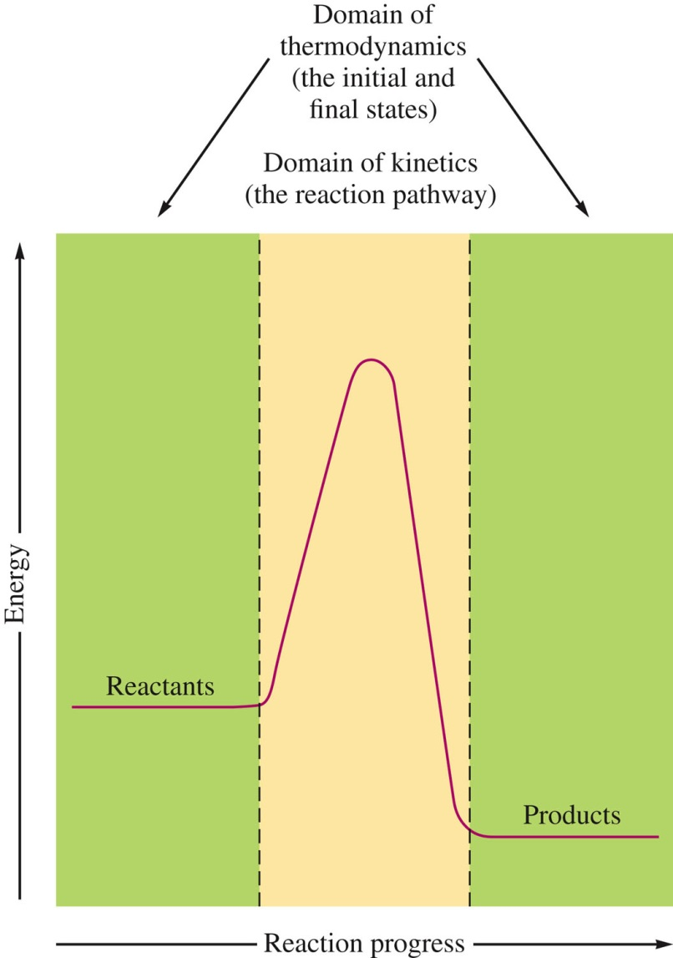
Thermodynamics vs. Kinetics

