Slide 1

Exam Info – February 18th
Be respectful – no electronics please!
7:00-8:30 pm – Rooms Posted Online
Conflict exam: Same day
  5-6:30 pm in 165 Noyes Lab
  Sign up for conflict in 1026 Chem Annex
Please email me if you have a conflict with both the regular exam and the conflict exam or get extended time.
Practice Exams posted online!
TAs will have review sessions.
You may use a calculator (NOT TI-Nspire.)

Slide 2
Announcements
Be respectful – no electronics please!
Exam 1 – Tuesday February 18, 7:00 pm
Pre & Post-lecture Assignments (Lon-Capa)
  8:00 am Thursday
Lon-Capa Homework 3 Due Tomorrow at 10:00 pm
Lab write-up 2 due Friday in discussion
Textbook homework Assignment 4 due Friday in discussion (pg. 16)
Work on Review Questions in Discussion Friday

Slide 3
Exam 1 Topics
Major Topics
Minor Topics
Matter
Naming
  Memorize polyatomics, especially those ending in “-ate”, hydroxide, ammonium
The mole
Empirical & molecular formula
Gases & related problems
Isotopes (protons, neutrons, electrons)
Conversion problems
Density
Chemical & physical changes
Not Tested
Significant Figures

Slide 4
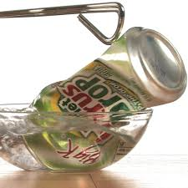
Pop Can Demonstration
As the pop can is taken off the hot plate and turned upside down over the cold water, the pressure in the can decreases. Why does the pressure decrease?
Why does the pop can collapse when this happens?

Slide 5

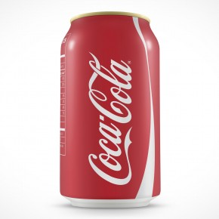
Pressure Differences
Pop Can Crushing
Balloon Expanding in Vacuum Chamber
Outside pressure greater
Inside pressure greater

Slide 6
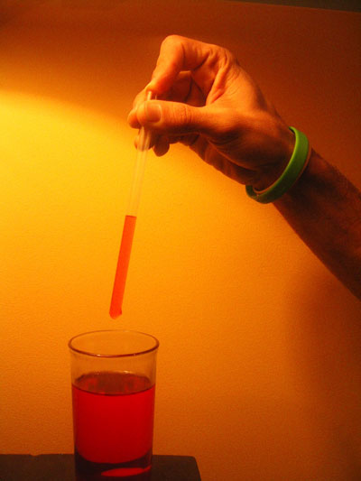
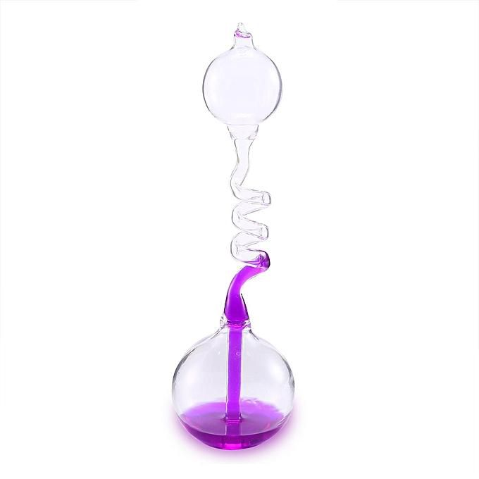
Pressure Differences
Water in Straw
Hand Boiler
Outside pressure greater
Outside pressure greater

Slide 7
Kinetic Molecular Theory
Gases are made of particles in constant random motion.
Average kinetic energy of a gas is proportional to its temperature.
Pressure is due to collisions of gas particles with the container.

Slide 8
KMT (assumptions)
Assume the volume of the gas particles is negligible (zero).
Assume that gas particles exert no attractive forces (elastic collisions).

Slide 9

Discussion #1
The two balloons above are the same size but contain different gases. How do the pressures inside the balloons compare?
1) The pressures are the same.
2) The balloon with helium (He) has the greater pressure.
3) The balloon with xenon (Xe) has the greater pressure.
4) Not enough information is given to answer this question.
Xe
He

Slide 10
Clicker #1
How do the average kinetic energies and particle spends compare?
Xe
He
 | Kinetic Energy | Particle Speed
a) | He = Xe | He = Xe
b) | He = Xe | He > Xe
c) | He > Xe | He < Xe
d) | He > Xe | He > Xe

Slide 11
Clicker #2
How do the numbers of particles and densities compare?
Xe
He
 | Number of Particles | Density
a) | He = Xe | He = Xe
b) | He > Xe | He < Xe
c) | He = Xe | He < Xe
d) | He < Xe | He < Xe

Slide 12
Clicker #3
You are holding three balloons each containing the same mass of gas. One balloon contains hydrogen gas, one contains helium, and one contains oxygen. Which balloon is the largest?
A) The hydrogen balloon is the largest.
B) The helium balloon is the largest.
C) The oxygen balloon is the largest.
D) All of the balloons are the same size.

Slide 13
Practice Question #1
A 50.0-L steel tank contains 20.0 mol N₂ and 40.0 mol O₂ at 31.7ºC. What is the partial pressure of each gas in the tank? What is the total pressure in the tank?

Slide 14
Practice Question #1
A 50.0-L steel tank contains 20.0 mol N₂ and 40.0 mol O₂ at 31.7ºC. What is the partial pressure of each gas in the tank? What is the total pressure in the tank?
What will the partial pressure of O₂ be?
1) Exactly 10.0 atm
2) Greater than 10.0 atm and less than 20.0 atm
3) Exactly 20.0 atm
4) Greater than 20.0 atm
5) The problem does not give enough information.

