Slide 1
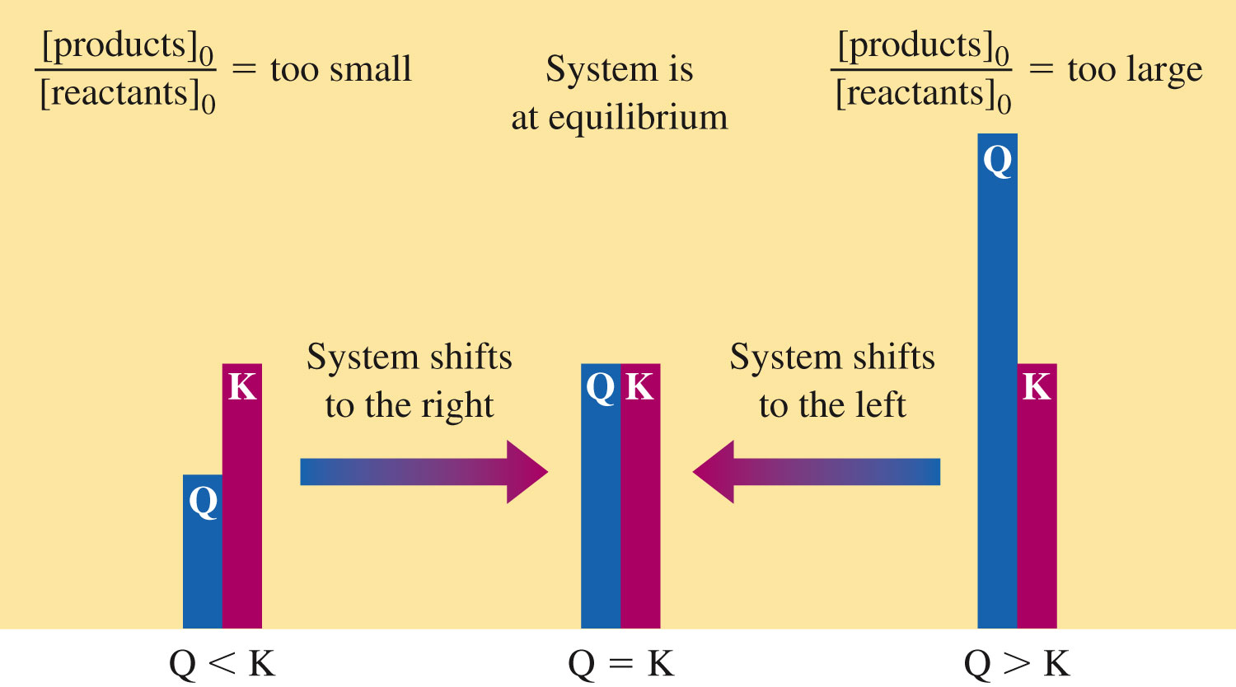
Reaction Quotient (Q)

Slide 2
Clicker Question
For this question, use the balanced equation N₂(g) + 3H₂(g) 2NH₃(g). You have three steel tanks each containing mixtures of N₂(g), H₂(g), and NH₃(g) at the same temperature. The conditions in the tanks are:
Tank 1: [N₂] = 2.00 M [H₂] = 3.00 M [NH₃] = 6.00 M
Tank 2: [N₂] = 2.00 M [H₂] = 4.00 M [NH₃] = 7.00 M
Tank 3: [N₂] = 3.00 M [H₂] = 2.00 M [NH₃] = 4.00 M
Two of the tanks have reach equilibrium. Which tank has not reached equilibrium, and which direction must the reaction proceed in order for that system to reach equilibrium?
a) Tank 1 has not reached equilibrium; the reaction in tank 1 must proceed to the left in order to reach equilibrium.
b) Tank 1 has not reached equilibrium; the reaction in tank 1 must proceed to the right in order to reach equilibrium.
c) Tank 2 has not reached equilibrium; the reaction in tank 2 must proceed to the left in order to reach equilibrium.
d) Tank 2 has not reached equilibrium; the reaction in tank 2 must proceed to the right in order to reach equilibrium.
e) Tank 3 has not reached equilibrium; the reaction in tank 3 must proceed to the left in order to reach equilibrium.

Slide 3
Clicker Question
Consider an initial mixture SO₂ and O₂ in which the partial pressure of SO₂ is 3.00 atm and the partial pressure of O₂ is 2.00 atm. These gases react according to the following equation:
2SO₂(g) + O₂(g) 2SO₃(g) K_{p} = 1.80 x 10⁻⁶
Determine the partial pressure of SO₃ at equilibrium (assume constant volume and temperature).
a) 1.64 x 10⁻³ atm
b) 2.85 x 10⁻³ atm
c) 5.69 x 10⁻³ atm
d) 5.40 x 10⁻⁶ atm
e) I don’t know.

Slide 4
Clicker Question
For a certain reaction at 25.0°C, the value of K is 1.2 × 10^{–3}. At 50.0°C the value of K is 3.4 × 10^{–1}.
This means that the reaction is
a) exothermic.
b) endothermic.
c) Impossible -- K cannot change
  d) More information is needed.
  e) I do not know.

