Slide 1
As always…
OWL
Lecture videos
Textbook
Read
Do text homework
Quiz #8 available now.

Slide 2
Previous Exam Question (1/2)
Consider the formation of N₂O(g) (skeletal structure is N–N–O) from N₂(g) and O₂(g).
Using all possible resonance structures and formal charge arguments, estimate ΔH_{f}° for N₂O(g) given the bond energies below.
Bond | Bond Energy
O=O | 495 kJ/mol
N–O | 201 kJ/mol
N=O | 607 kJ/mol
N≡O | 814 kJ/mol
N–N | 160 kJ/mol
N=N | 418 kJ/mol
N≡N | 941 kJ/mol

Slide 3
Previous Exam Question (2/2)
Consider the formation of N₂O(g) (skeletal structure is N–N–O) from N₂(g) and O₂(g).
The actual value of ΔH_{f}° for N₂O(g) is 82 kJ/mol. Compare this answer to your previous answer.
How does it support your choice of most favorable resonance structures based on formal charge?
Why is the answer (82 kJ/mol) not exactly the same as any one of your calculations in part “a”?

Slide 4
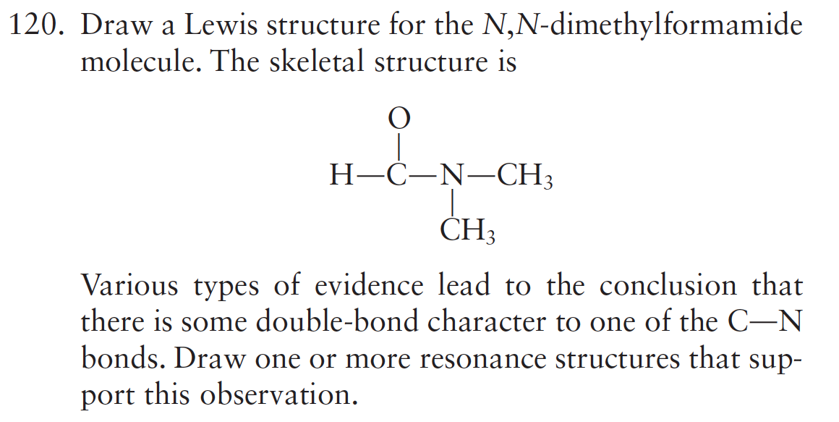
Chapter 13

Slide 5
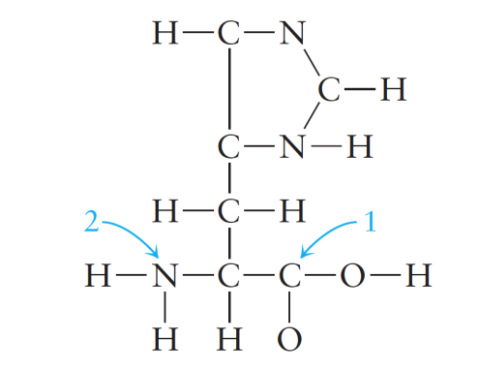
Clicker Question
Which of the following best describes the shape around the carbon atom labeled 1 and the nitrogen atom labeled 2?
Carbon atom (#1) Nitrogen atom (#2)
a) tetrahedral tetrahedral
b) trigonal pyramid trigonal planar
c) trigonal planar trigonal pyramid
d) trigonal pyramid trigonal pyramid
e) trigonal planar tetrahedral

Slide 6
Three Big Topics
Stoichiometry: information on “what” happens; allows us to determine amounts of reactants and products.
Thermodynamics: information on “why” reactions happen; allows us to make predictions about whether a reaction will occur.
Kinetics: information on “how” reactions happen (mechanisms); relates to the speed of reactions.

Slide 7
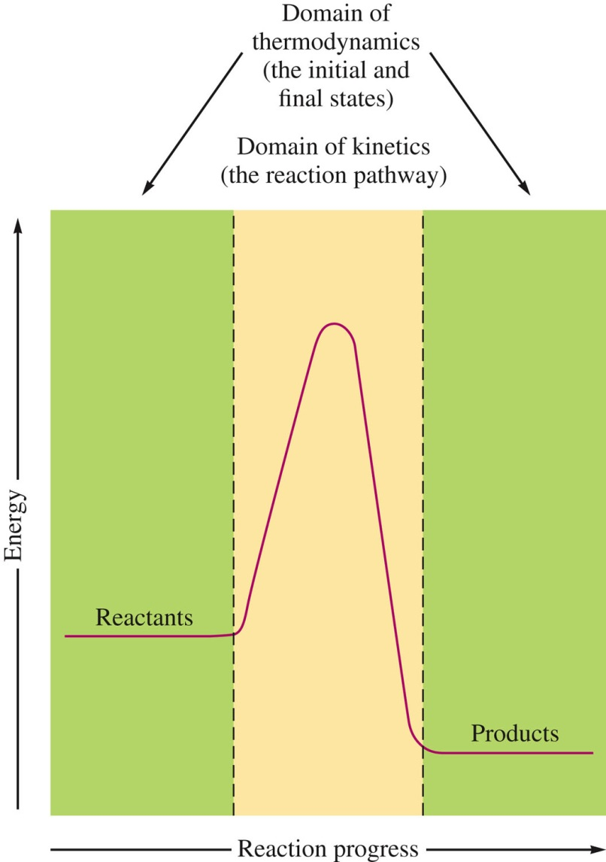
Thermodynamics vs. Kinetics

Slide 8
Good to Know…

Slide 9
Clicker Question
For the hypothetical reaction A + 2B → 3C, the following data were collected. The rate law for the reaction is: rate = (d[C]/dt) =
[A]₀ [B]₀ Initial Rate (d[C]/dt)
0.010 M 0.010 M 1.8 x 10⁻⁵ Ms⁻¹
0.020 M 0.010 M 7.2 x 10⁻⁵ Ms⁻¹
0.010 M 0.020 M 3.6 x 10⁻⁵ Ms⁻¹
a) k[A]²[B]
b) k[A]²[B]²
c) k[A][B]
d) k[A][B]²
e) I’m not sure

Slide 10
Clicker Question
Radioactive nuclei decay according to first-order kinetics. If a radioactive sample decays from 1.00 x 10⁴ nuclei to 625 nuclei in 10.0 minutes, determine the half-life of this radioactive species.
a) 0.667 min
b) 1.50 min
c) 2.00 min
d) 2.50 min
e) 5.33 min

