Slide 1
Lecture 2
Introduction to Acids and Bases

Slide 2
Quiz Schedule
Quiz 1 is tomorrow during your noon quiz section. The quiz will cover the Monday and Tuesday week 1 assignments. The even numbered assigned Zumdahl problems from these two homework sets will be checked during the noon quiz section tomorrow. As always, answers to the Review questions are not required.
Quiz 2 is Monday, June 19 and it will concentrate on the Wednesday and Thursday week 1 assignments. Homework from these two assignments will be checked on June 19 during quiz section.

Slide 3
Lecture 2
Introduction to Acids and Bases

Slide 4
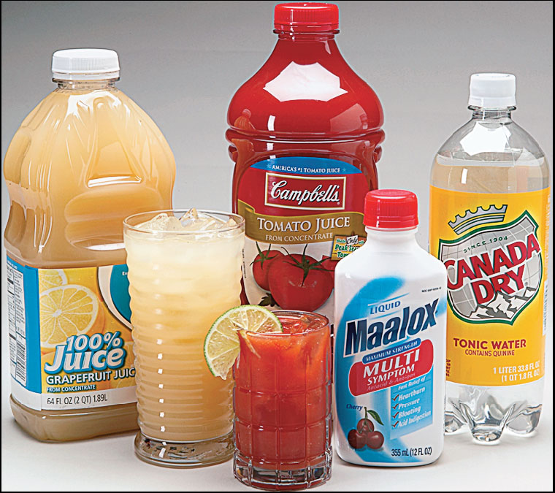
Acidic or Basic Beverages
Photo © Brooks/Cole, Cengage Learning Company. All rights reserved.

Slide 5
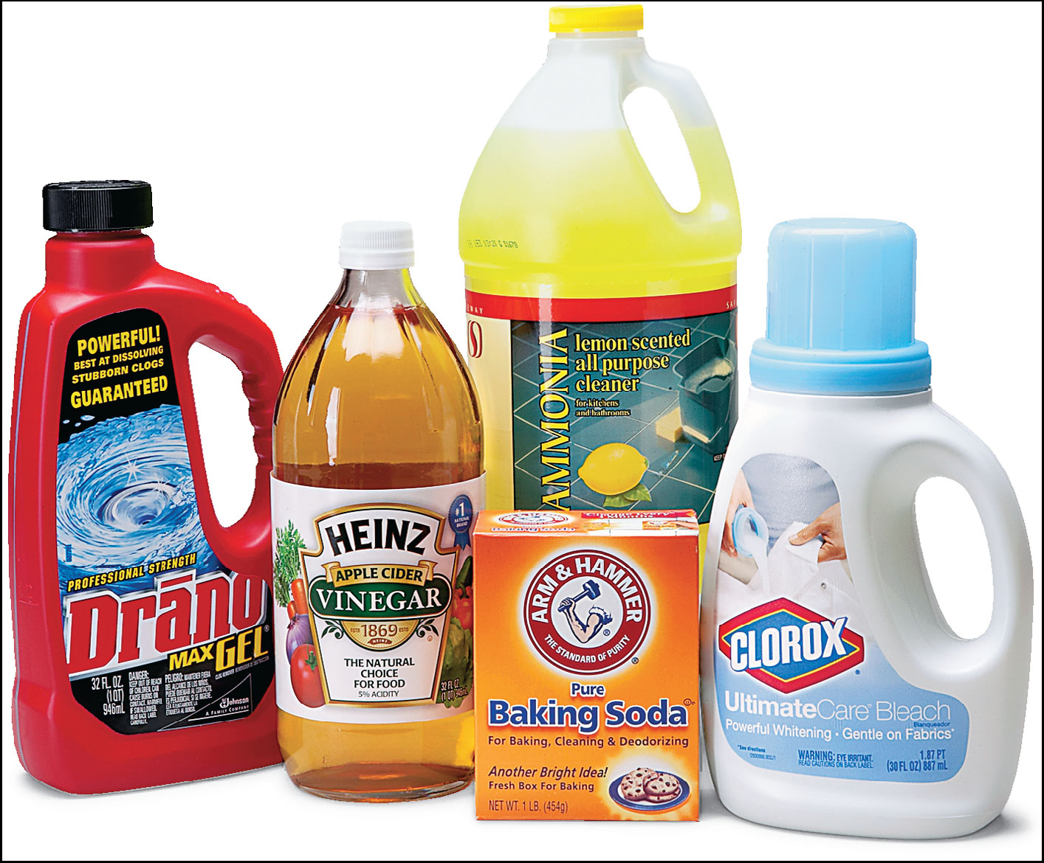
Household Chemicals
Photo © Brooks/Cole, Cengage Learning Company. All rights reserved.

Slide 6
Figure 14.2: Reaction of Acid HA with Water
HA(aq) + H₂O(l) ↔ H₃O⁺(aq) + Cl⁻(aq)

Slide 7
Definitions of Acids and Bases-p 80
Acid-base reactions are called proton transfer reactions. In a chemical reaction, H⁺ is the symbol for a proton. So acid-base reactions are ones that involve the transfer of a proton (H⁺) from one species to another.
Acid = proton (H⁺) donor; simple acid = HA
Base = proton (H⁺) acceptor; simple base = B

Slide 8
Acids and Bases in Water-p 80
General Acid Reaction in Water (K_{a} reaction):
HA(aq) + H₂O(l) ↔ A⁻(aq) + H₃O⁺(aq)
General Base Reaction in Water (K_{b} reaction):
B(aq) + H₂O(l) ↔ BH⁺(aq) + OH⁻(aq)

Slide 9
Acids and Bases in Water-p 80
General Acid Reaction in Water (K_{a} reaction):
HA(aq) + H₂O(l) ↔ A⁻(aq) + H₃O⁺(aq)
General Base Reaction in Water (K_{b} reaction):
B(aq) + H₂O(l) ↔ BH⁺(aq) + OH⁻(aq)

Slide 10
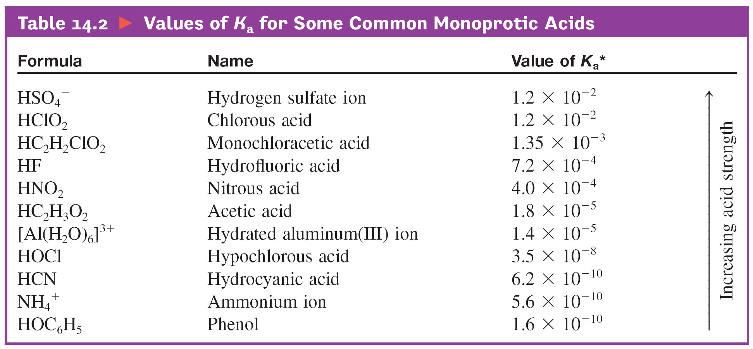
Values for K_{a} for Some Common Monoprotic Acids-p 81
As K_{a} value increases, more of the acid reacts with water (more of the
acid dissociates), and the more acidic the solution ([H⁺] increases).

Slide 11
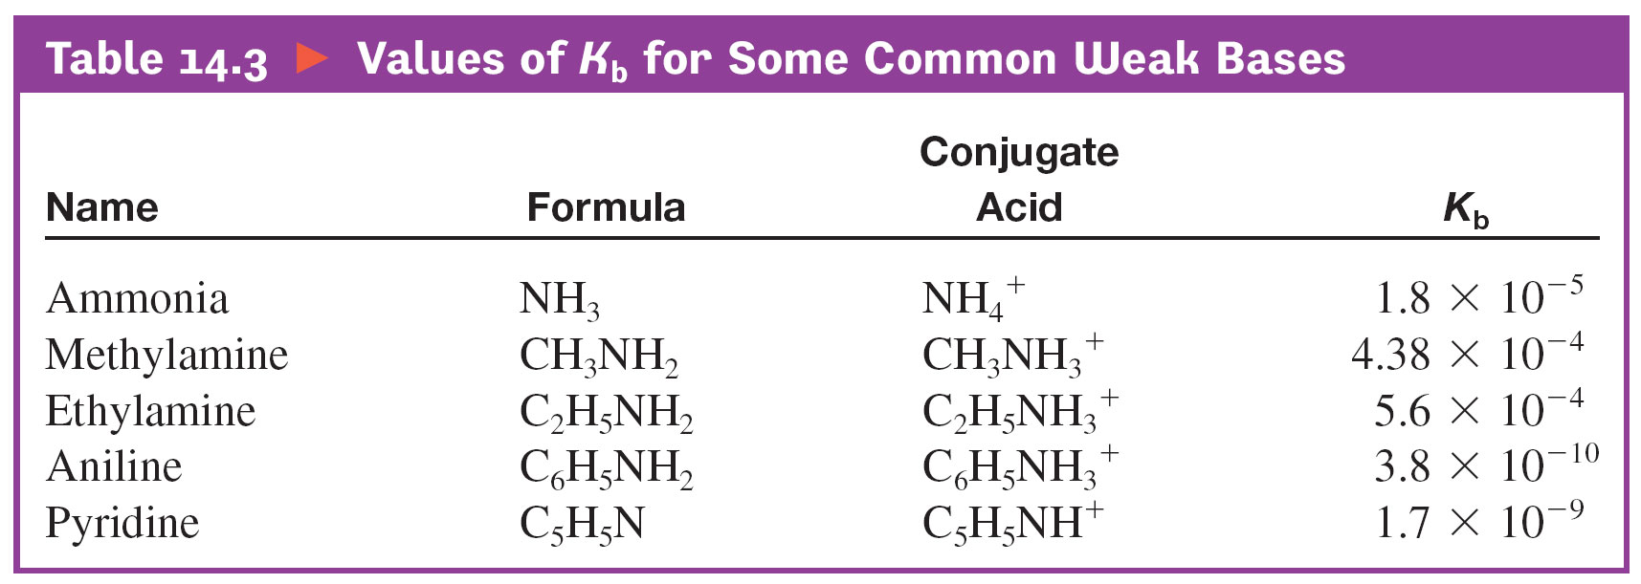
Values for K_{b} for Some Common Weak Bases-p. 81
As K_{b} increases, the more of the base that reacts with water and the
more OH⁻ that is produced (the more basic the solution).

Slide 12
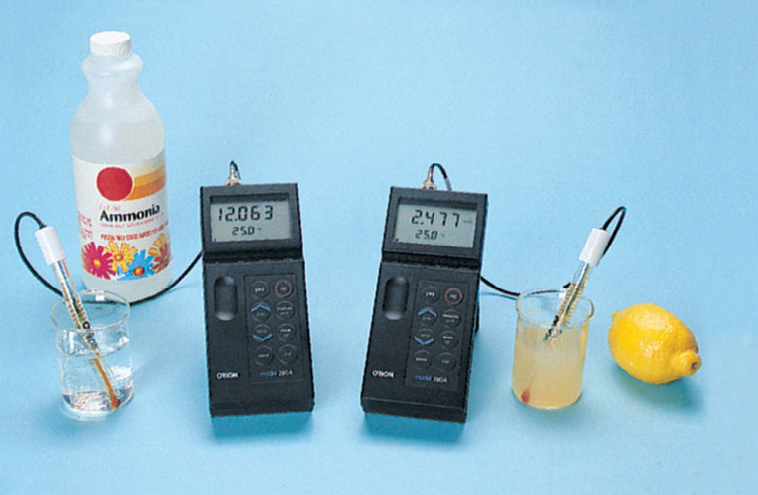
Fig 14.7: pH Meters
Ken O'Donoghue

Slide 13
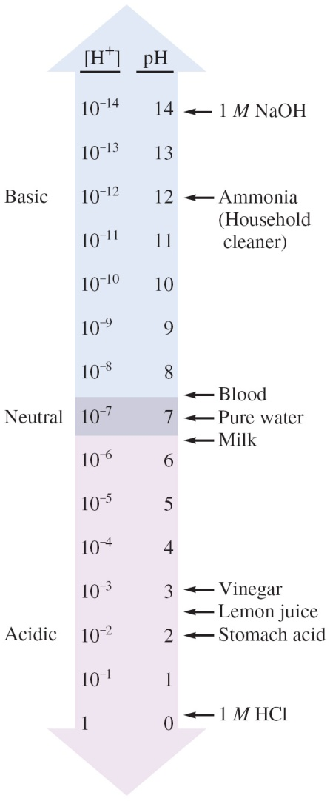
Figure 14.6: The pH Scale and pH Values of Some Common Substances

Slide 14
Figure 14.6: The pH Scale and pH Values of Some Common Substances (p. 84)
2 H₂O(l) ↔ H₃O⁺(aq) + OH⁻(aq)
or
H₂O(l) ↔ H⁺(aq) + OH⁻(aq)
K_{w} = [H⁺][OH⁻] = 1.0 x 10⁻¹⁴
pH = -log[H⁺]
pOH = -log[OH⁻]
pH + pOH = 14.00

Slide 15
Figure 14.6: The pH Scale and pH Values of Some Common Substances (p. 84)
2 H₂O(l) ↔ H₃O⁺(aq) + OH⁻(aq)
or
H₂O(l) ↔ H⁺(aq) + OH⁻(aq)
K_{w} = [H⁺][OH⁻] = 1.0 x 10⁻¹⁴
pH = -log[H⁺]
pOH = -log[OH⁻]
pH + pOH = 14.00
Acids add H₃O⁺ (usually abbreviated as H⁺) to solution.

Slide 16
Figure 14.6: The pH Scale and pH Values of Some Common Substances (p. 84)
H₂O(l) ↔ H⁺(aq) + OH⁻(aq)
K_{w} = [H⁺][OH⁻] = 1.0 x 10⁻¹⁴
pH = -log[H⁺]
pOH = -log[OH⁻]
pH + pOH = 14.00
Bases add OH⁻ to solution.
Acids add H⁺ to solution.

Slide 17
Figure 14.6: The pH Scale and pH Values of Some Common Substances – p. 84
H₂O(l) ↔ H⁺(aq) + OH⁻(aq)
K_{w} = [H⁺][OH⁻] = 1.0 x 10⁻¹⁴
pH = -log[H⁺]
pOH = -log[OH⁻]
pH + pOH = 14.00
Bases add OH⁻ to water.
A basic solution has:
large [OH⁻], so small [H⁺]
low pOH, so high pH
Acids add H⁺ to water.
An acidic solution has:
large [H⁺], so small [OH⁻]
low pH, so high pOH

Slide 18
Lecture Question-p. 79.5
A solution has a pOH of 5.62. Is this an acidic, basic, or neutral solution at 25ºC? Calculate the pH, [H⁺], and [OH⁻] of this solution.
Useful equations at 25ºC:
[H⁺][OH⁻]= K_{w} = 1.0 x 10⁻¹⁴
pH = −log[H⁺]; pOH = −log[OH⁻]
pH + pOH = 14.00
[H⁺] = 10^{−pH}; [OH ⁻] = 10^{−pOH}

Slide 19
Acids in Water-p 80
General Acid Reaction in Water (K_{a} reaction):
HA(aq) + H₂O(l) ↔ A⁻(aq) + H₃O⁺(aq)
or: HA(aq) ↔ A⁻(aq) + H⁺(aq)

Slide 20
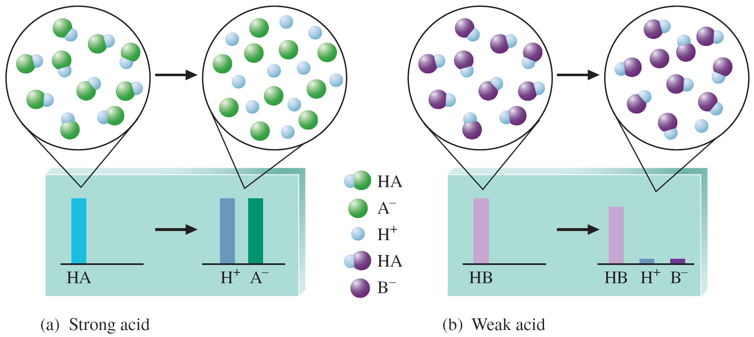
Figure 14.4: (a) Strong Acid HA Ionized in Water; (B) Weak Acid HB
K_{a} reaction:
HX(aq) + H₂O(l) ↔ X⁻(aq) + H₃O⁺(aq)
or: HX(aq) ↔ X⁻(aq) + H⁺(aq)

Slide 21
Strong Acids Characteristics (p. 82)
-Are great at what they do (great at donating protons, H⁺)
-At equilibrium, 99.99% of the strong acid has reacted with water (has dissociated). For simplicity, we will assume strong acids are 100% reacted (dissociated) in water.
-Strong acids have K_{a} values which are very, very large (K_{a} >> 1); at equilibrium, strong acids have mostly products present.
-Memorize the strong acids (HCl, HBr, HI, HNO₃, HClO₄, and H₂SO₄)

Slide 22
Figure 14.4: (a) Strong Acid HA Ionized in Water; (B) Weak Acid HB
Strong acids: K_{a}>>1
Weak acids: K_{a} < 1

Slide 23
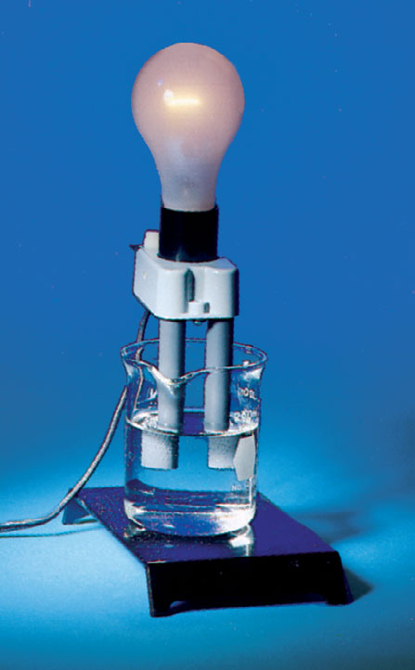
Dimly Lit Bulb in Acetic Acid Solution (a Weak Acid Solution)
HX(aq) ↔ X⁻(aq) + H⁺(aq)
Ken O'Donoghue

Slide 24
Dimly Lit Bulb in Acetic Acid Solution (a Weak Acid Solution)
HX(aq) ↔ X⁻(aq) + H⁺(aq)
K_{a} < 1, so mostly HX in solution;
Very few ions
Ken O'Donoghue

Slide 25
Weak Acid Characteristics (p. 82)
- Weak acids are poor at what they do (poor at donating protons to water)
-At equilibrium, only ~0.1 - 10% of the acid has reacted with water (has dissociated). At equilibrium, the acid mostly stays together in the HX form.
-Weak acids all have K_{a} values which are less than 1 (K_{a} < 1). Weak acids in water have mostly reactants present.

Slide 26
Recognizing Weak Acids-p. 82
There are millions of weak acids. How do you recognize weak acids?

Slide 27
Recognizing Weak Acids-p. 82
There are millions of weak acids. How do you recognize weak acids?
You look up to see if the substance has a K_{a} value less than 1 (K_{a} < 1). If it does, then it is a weak acid. References available to you are Table 14.2 and Appendix A5.1 of the text. Use them! We do not want you to try to memorize all the weak acids; it is impossible.

Slide 28
Values for K_{a} for Some Common Monoprotic Acids
Example K_{a} reaction for HNO₂, K_{a} = 4.0 x 10⁻⁴:
HNO₂(aq) + H₂O(l) ↔ H₃O⁺(aq) + NO₂⁻(aq)
or: HNO₂(aq) ↔ H⁺(aq) + NO₂⁻(aq)

Slide 29
Values for K_{a} for Some Common Monoprotic Acids-p. 81
As K_{a} value increases, more of the acid reacts with water (more of the
acid dissociates), and the more acidic the solution ([H⁺] increases).

Slide 30
Categorizing Acids-p. 82
All strong acids have K_{a} >> 1. For example, K_{a} for HCl is about 1 x 10⁶.
All weak acids have K_{a} < 1. For example, K_{a} for the weak acid HOC₆H₅ = 1.6 x 10⁻¹⁰. Other examples are in Table 14.2 of the text.
Third category?

Slide 31
Categorizing Acids-p. 82
All strong acids have K_{a} >> 1. For example, K_{a} for HCl is about 1 x 10⁶.
All weak acids have K_{a} < 1. For example, K_{a} for the weak acid HOC₆H₅ = 1.6 x 10⁻¹⁰. Other examples are in Table 14.2 of the text.
Third category = worthless acids
Worthless acids are weaker acids than water, that is, they have K_{a} < K_{w} (K_{a} < 1.0 x 10⁻¹⁴ ).

Slide 32
Lecture Question-p. 82.5
HNO₂ has K_{a} = 4.0 x 10⁻⁴ and HCN has K_{a} = 6.2 x 10⁻¹⁰. Which of the following statements is true?
a. HCN is a stronger acid than HNO₂.
b. HNO₂ is a strong acid.
c. At equilibrium in a 1.0 M HCN solution, [CN⁻] >> [HCN].
d. The pH of a 1.0 M HNO₂ solution will be lower than the pH of a 1.0 M HCN solution.
e. None of the these statements are true.

Slide 33
Lecture Question
HNO₂ has K_{a} = 4.0 x 10⁻⁴ and HCN has K_{a} = 6.2 x 10⁻¹⁰. Which of the following statements is true?
a. HCN is a stronger acid than HNO₂.
b. HNO₂ is a strong acid.
c. At equilibrium in a 1.0 M HCN solution, [CN⁻] >> [HCN].
d. The pH of a 1.0 M HNO₂ solution will be lower than the pH of a 1.0 M HCN solution.
e. None of the these statements are true.

Slide 34
Strong Bases (p. 82)
-Strong bases increase the [OH⁻] concentration of water by dissolving (strong bases to memorize are the soluble ionic hydroxide salts).
- LiOH, NaOH, KOH, RbOH, CsOH, Ca(OH)₂, Sr(OH)₂, and Ba(OH)₂ are the strong bases to memorize.
-Similar to strong acids, these strong bases are assumed to break up 100% of the time when dissolved in water.

Slide 35
Weak Bases in Water (p. 82)
-Weak bases increase the [OH⁻] in water through the K_{b} reaction.
-K_{b} reaction:
B(aq) + H₂O(l) ↔ BH⁺(aq) + OH⁻(aq)
-Weak bases all have K_{b} values less than 1 (K_{b} < 1). Identify weak bases by looking up K_{b} values in Table 14.3 or Appendix A5.3 of the text.

Slide 36
Values for K_{b} for Some Common Weak Bases
Example K_{b} reaction for C₅H₅N, K_{b} = 1.7 x 10⁻⁹:
C₅H₅N(aq) + H₂O(l) ↔ OH⁻(aq) + C₅H₅NH⁺(aq)

Slide 37
Values for K_{b} for Some Common Weak Bases-p. 81
As K_{b} increases, the more of the base that reacts with water and the
more OH⁻ that is produced (the more basic the solution).

Slide 38
Lecture Question – p. 82.5
Consider a 0.25 M C₅H₅N (K_{b} = 1.7 x 10⁻⁹) solution and a 0.25 M CH₃NH₂ (K_{b} = 4.4 x 10⁻⁴) solution. How many of the following statements are true regarding these two solutions?
I. 0.25 M C₅H₅N will have a lower pH.
II. 0.25 M CH₃NH₂ will have a lower pOH.
III. 0.25 M CH₃NH₂ will have the smaller [H⁺].
IV. 0.25 M C₅H₅N will have the smaller [OH⁻].
a. none b. 1 c. 2 d. 3 e. 4 (All are true.)

Slide 39
Clicker Question
Consider a 0.25 M C₅H₅N (K_{b} = 1.7 x 10⁻⁹) solution and a 0.25 M CH₃NH₂ (K_{b} = 4.4 x 10⁻⁴) solution. How many of the following statements are true regarding these two solutions?
I. 0.25 M C₅H₅N will have a lower pH.
II. 0.25 M CH₃NH₂ will have a lower pOH.
III. 0.25 M CH₃NH₂ will have the smaller [H⁺].
IV. 0.25 M C₅H₅N will have the smaller [OH⁻].
a. none b. 1 c. 2 d. 3 e. 4 (All are true.)

Slide 40
Conjugate Acid-Base Pairs (p. 83)
Pairs of substances that only differ by a proton (H⁺) in their formulas are called conjugate acid-base pairs.
Examples of conjugate acid-base pairs:
HBr and Br⁻
HC₂H₃O₂ and C₂H₃O₂⁻
HOCl and OCl⁻
NH₄⁺ and NH₃
HONH₃⁺ and HONH₂

Slide 41
Conjugate Acid-Base Pairs (p. 83)
-As the name indicates, one species in a conjugate acid-base pair behaves as an acid (H⁺ donor), while the other species in the pair behaves as a base (H⁺ acceptor).
-To determine how good an acid or base something is, you need to determine the K_{a} or K_{b} value.
-For all conjugate acid-base pairs:
K_{a} x K_{b} = K_{w} (At 25ºC, K_{w} = 1.0 x 10⁻¹⁴)
-See p. 85 of the Handouts packet for a derivation of this formula.

Slide 42
Using K_{a} x K_{b} = K_{w} = 1.0 x 10⁻¹⁴ (p. 83)
For HNO₂, K_{a} = 4.0 x 10⁻⁴ and the conjugate base is NO₂⁻ . What type of base is NO₂⁻?
K_{b} for NO₂⁻ = K_{w}/K_{a} for HNO₂

Slide 43
Using K_{a} x K_{b} = K_{w} = 1.0 x 10⁻¹⁴ (p. 83)
For HCl, K_{a} ≈ 1 x 10⁶ and the conjugate base is
Cl⁻. What type of base is Cl⁻?
K_{b} for Cl⁻ = K_{w}/K_{a} for HCl
We call Cl⁻ a worthless base because
K_{b} << K_{w} = 1.0 x 10⁻¹⁴.

Slide 44
Using K_{a} x K_{b} = K_{w} = 1.0 x 10⁻¹⁴ (p. 83)
For NH₃, K_{b} = 1.8 x 10⁻⁵ and the conjugate acid is NH₄⁺ . What type of acid is NH₄⁺?
K_{a} for NH₄⁺ = K_{w}/K_{b} for NH₃

Slide 45
Using K_{a} x K_{b} = K_{w} = 1.0 x 10⁻¹⁴ (p. 83)
For NH₃, K_{b} = 1.8 x 10⁻⁵ and the conjugate acid is NH₄⁺ . What type of acid is NH₄⁺?
K_{a} for NH₄⁺ = K_{w}/K_{b} for NH₃
One of my favorite sayings with acid-base chemistry is that weak gives you weak, and strong gives you garbage. What does this saying refer to?

