Slide 1
Hybrid Orbital Theory

Slide 2
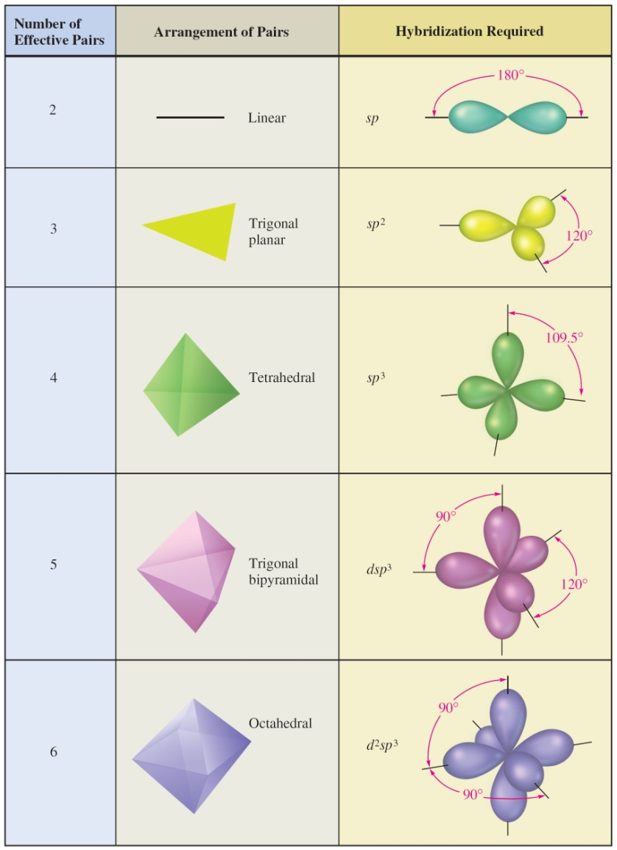
Figure 9.24: Effective Pairs, Their Spatial Arrangement, and Required Hybridization
Don’t need for
Organic chem.

Slide 3
Figure 9.24: Effective Pairs, Their Spatial Arrangement, and Required Hybridization

Slide 4
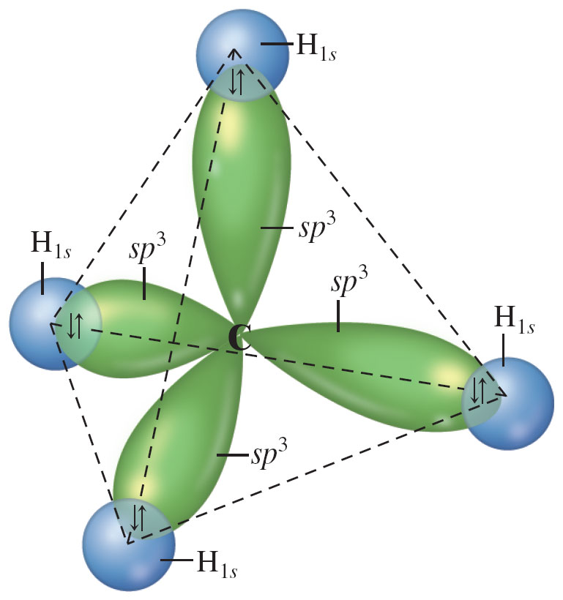
Figure 22.1: The C–H Bonds in Methane, CH₄

Slide 5
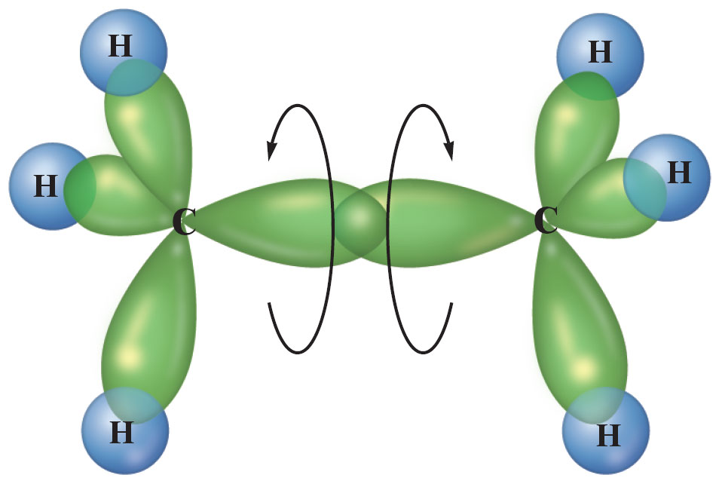
Figure 22.8: Bonding in Ethane, C₂H₆

Slide 6
NH₃ Bonding
Explain the bonding in NH₃, i.e., what orbitals overlap to form the bonds in NH₃. Are these sigma (σ) or pi (π) bonds?

Slide 7
Figure 9.24: Effective Pairs, Their Spatial Arrangement, and Required Hybridization

Slide 8
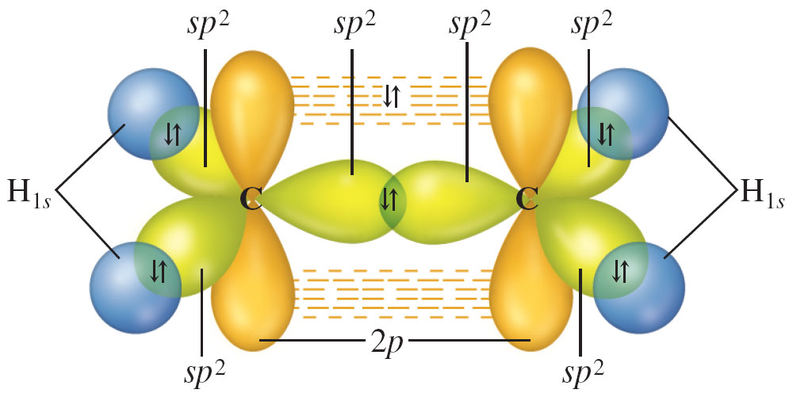
Figure 22.7: Bonding in Ethylene, C₂H₄

Slide 9
Figure 9.24: Effective Pairs, Their Spatial Arrangement, and Required Hybridization

Slide 10
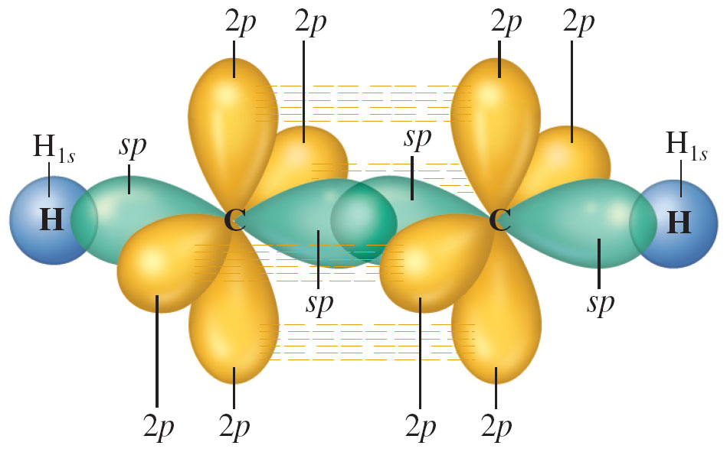
Figure 22.10: Bonding in Acetylene, C₂H₂

Slide 11
Figure 9.24: Effective Pairs, Their Spatial Arrangement, and Required Hybridization

Slide 12
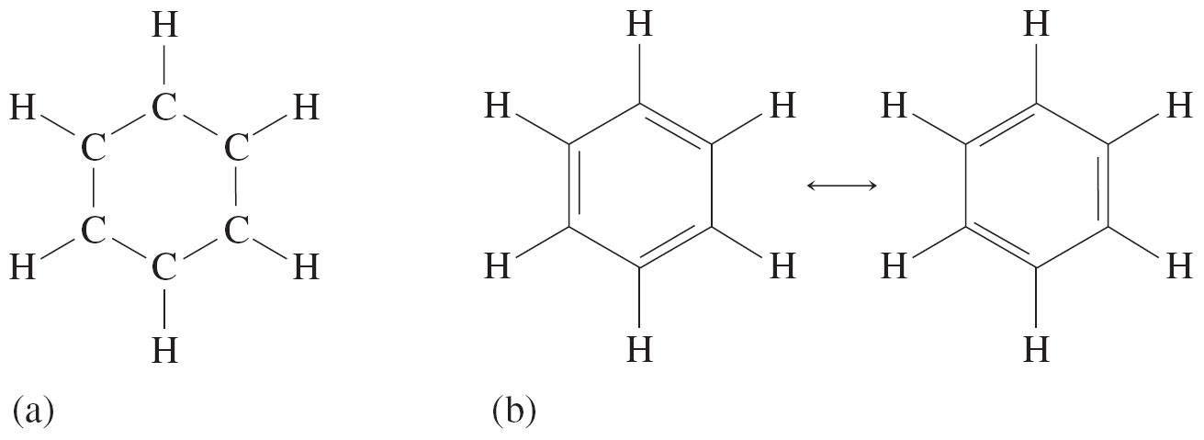
Figure 9.45: (a) skeletal structure for benzene (b) two resonance structures for benzene molecule
Benzene = C₆H₆: 6(5) + 6(1) = 30 valence electrons

Slide 13
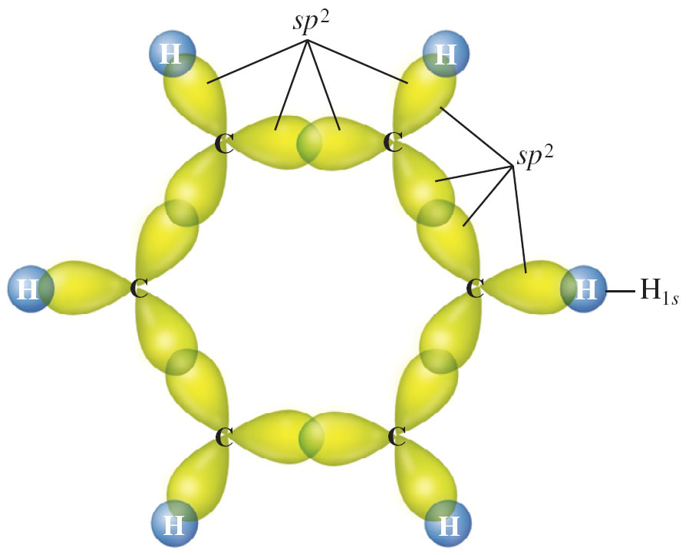
Figure 9.46: σ Bonding System in Benzene Molecule

Slide 14
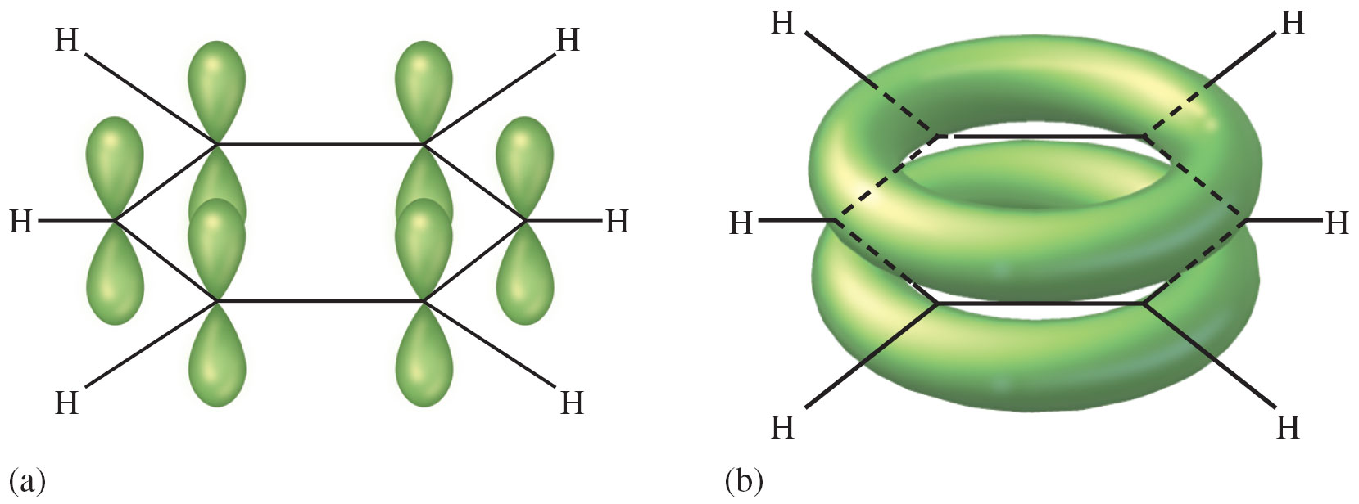
Figure 9.47: (a) unhybridized p atomic orbitals in benzene; (b) delocalized π electrons over entire ring of C atoms

