Slide 1
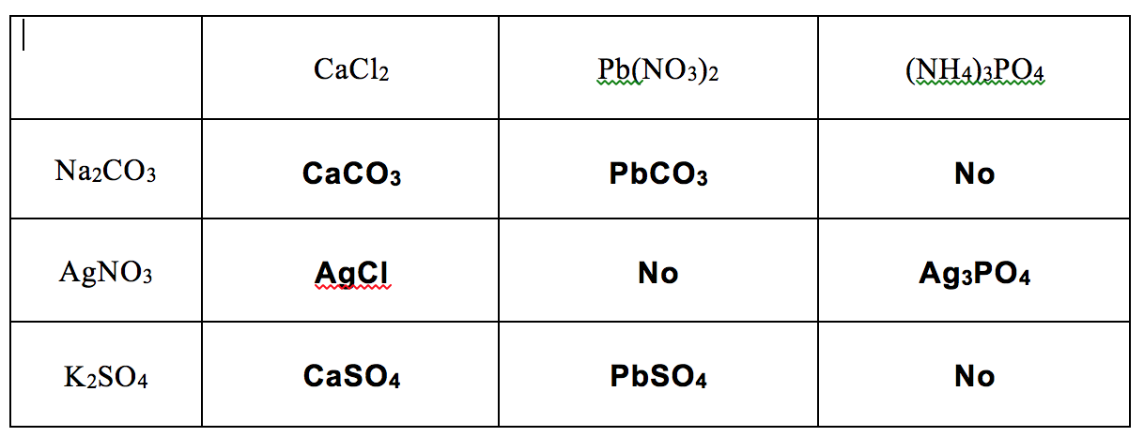
Fall 2014 Exam II
1. e 9. c 16. a) see below
2. a 10. b b) 37.5 mL of 2.00 M CaCl₂ needed
3. e 11. b Measure out 37.5 mL of 2.00 M CaCl₂.
4. d 12. a Pour it into a flask, add water until the
5. a 13. d total volume of solution is 300.0 mL.
6. e 14. d c) draw appropriate ions
7. e 15. c
8. b
17. a) CaC₂(s) + 2H₂O(l) → C₂H₂(g) + Ca(OH)₂(aq)
2C₂H₂(g) + 5O₂(g) → 4CO₂(g) + 2H₂O(g)
b) H₂O (LR) 16. a)
c) 67.9 L
d) 150.0 g (before = after)

