Slide 1
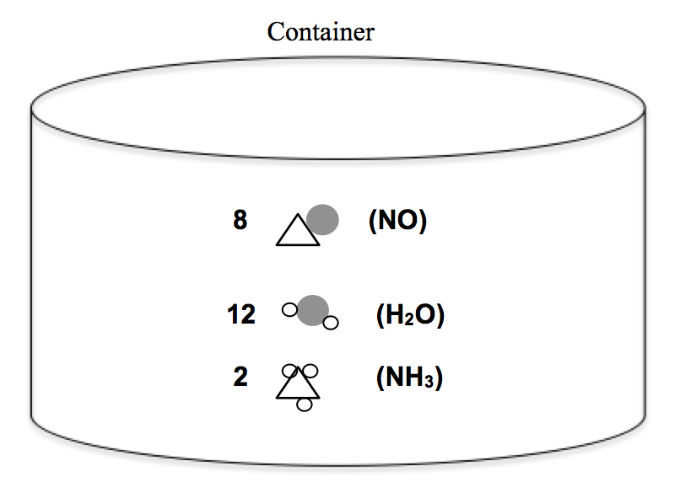
Fall 2015 Exam II
1. a 9. d 16. a) 8 molecules NO
2. e 10. b 12 molecules H₂O
3. c 11. d 2 molecules NH₃ leftover
4. b 12. e TOTAL = 22 molecules
5. a 13. d b)
6. e 14. c
7. b 15. c
8. a
17. a) 10N₂O(g) + C₃H₈(g) → 10N₂(g) + 3CO₂(g) + 4H₂O(g)
b) 0.21 atm CO₂
c) 0 atm N₂O (LR = all used up) c) 3.987 x 10⁻²² g NO

