Slide 1
Fall 2018 Exam III
1. c 9. b 16. (next slides)
2. e 10. b 17. (next slides)
3. c 11. d
4. a 12. a
5. c 13. d
6. a 14. a
7. e 15. e
8. d

Slide 2
16.
+2
+5 total
c. Yes, it is possible for an electron to be closer to or further from the nucleus than 48 pm. This is because electrons can be found within orbitals, which only approximate electron location 90% of the time. The electron can be found within any part of the orbital, some parts of which may be closer than 48 pm, and 10% of the time it can be found outside of the orbital.
d. The bond between oxygen and oxygen is nonpolar, whereas the bonds between Se and O and Mo and O are both polar. A bond is nonpolar or nonpolar covalent when electrons are shared evenly between two atoms because both atoms have the same electronegavity. A bond is polar when electrons are unequally shared due to the differences in electronegativity between the atoms. The electrons are more likely to spend time around the more electronegative element within a polar bond. For example, electrons will spent more time around the oxygen atom in the bond between Se and O.
16. a.
1) Se, 2
2) O, 2
3) Mo, 6
b.
1) 103 pm
2) 48 pm
3) 190 pm

Slide 3
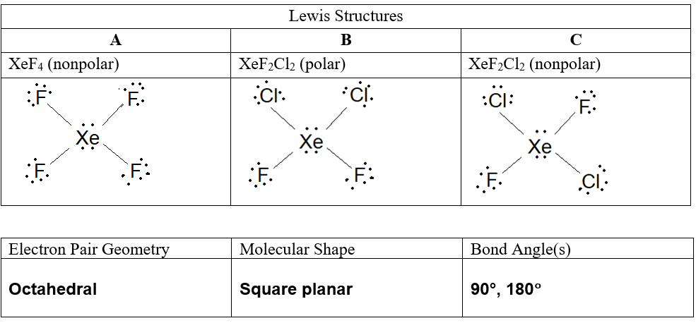
17.

Slide 4
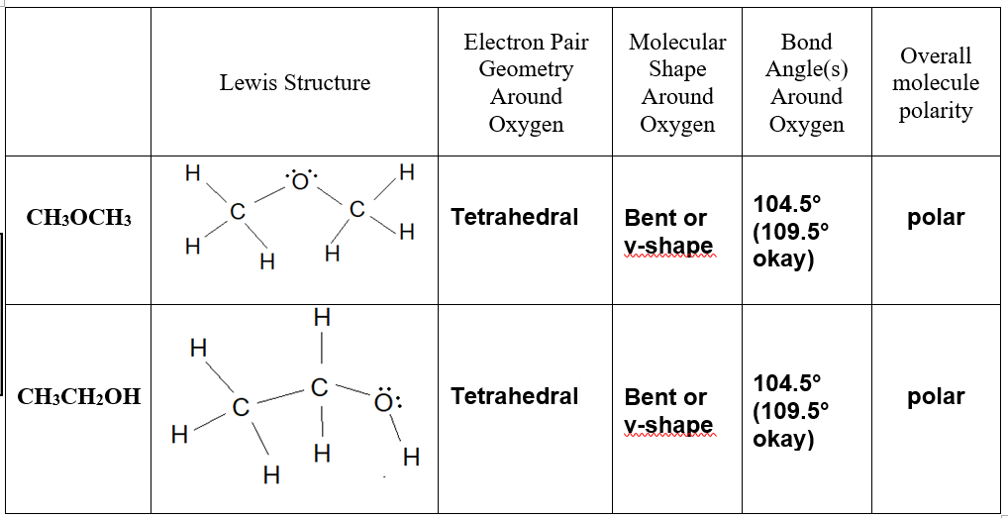
17. continued
a. Both XeF₄ and the nonpolar form of XeF₂Cl₂ have London dispersion forces, which are weaker than the dipole dipole forces that the polar form of XeF₂Cl₂ has. The London dispersion forces in nonpolar XeF₂Cl₂ are stronger than those in XeF₄ due to the higher molar of XeF₂Cl₂ and greater number of electrons.

Slide 5
17. continued
c. No, they do not have the same boiling point. Both are polar, and CH₃OCH₃ has dipole-dipole forces between its molecules. CH₃CH₂OH also has hydrogen bonding forces because it has a direct O-H bond. These hydrogen bonding forces are stronger than the dipole-dipole bonding forces in CH₃OCH₃. Therefore, CH₃CH₂OH has a higher boiling point.

